Slide 1
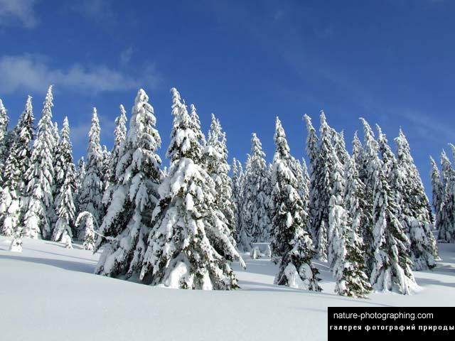
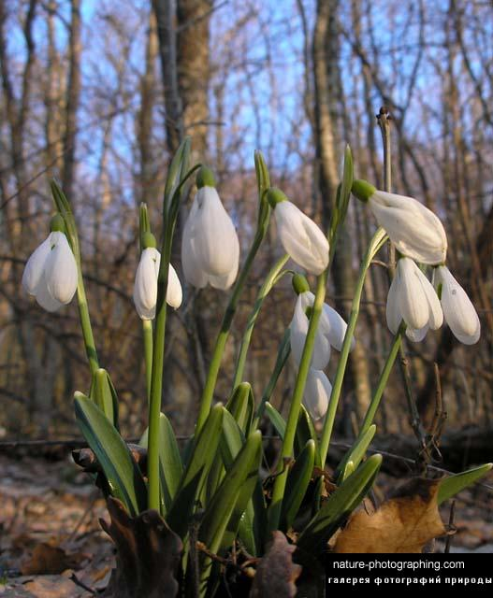
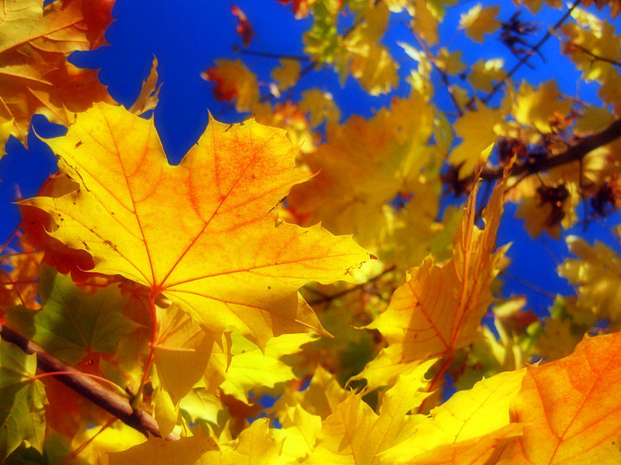
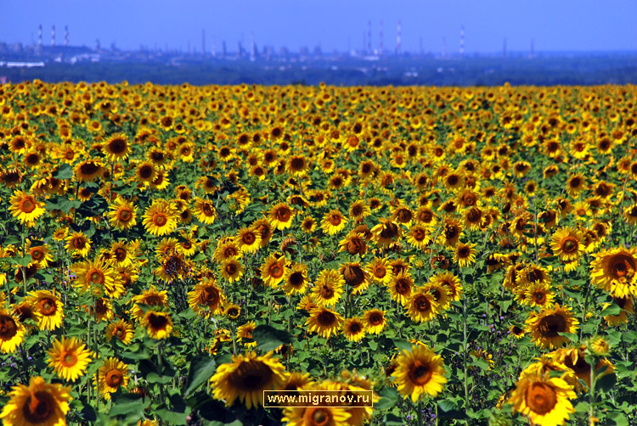
.
THE ENGLISH YEAR
SEASONS

Slide 2
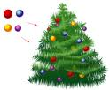
This is the season
When children ski
And Father Frost
Brings the New Year Tree.

Slide 3
WINTER

Slide 4
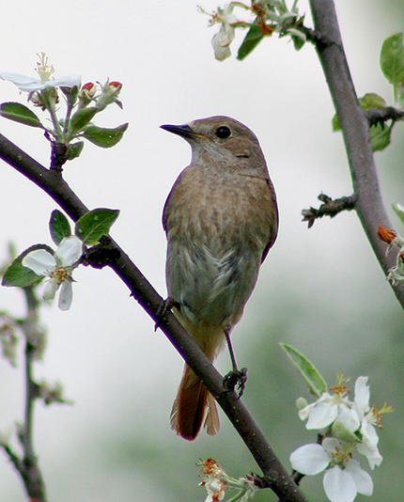
This is the season
When birds make their nests
This is the season
We all like best.

Slide 5
SPRING

Slide 6
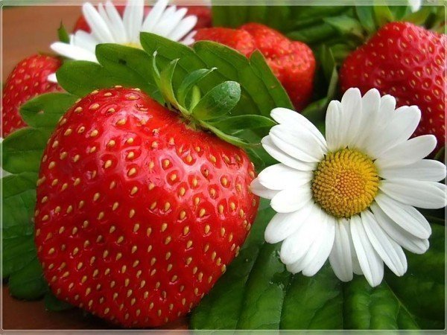
This is the season
When nights are short
And children have plenty
Of fun and sport.

Slide 7
SUMMER

Slide 8
This is the season
When fruit is sweet,
This is the season
When school friends meet.

Slide 9
AUTUMN

Slide 10
.
My favourite season is …
My favourite seasons are...

Slide 15
WINTER: DECEMBER JANUARY FEBRUARY
NOVEMBER
DECEMBER
JANUARY
FEBRUARY

Slide 16
SPRING: MARCH APRIL MAY
MARCH
APRIL

Slide 17
SUMMER: JUNE JULY AUGUST
MAY
JUNE
JULY
AUGUST

Slide 18
AUTUMN: SEPTEMBER OCTOBER NOVEMBER
SEPTEMBER
OCTOBER

Slide 33
TRUE OR FALSE:
There are twelve months in a year.
In Great Britain there are 3 summer months.
In winter in Great Britain it rains and snows.
Summer comes after winter.
In November in America there is a great holiday-Thanksgiving Day.
June comes after August.
Winter is the coldest season of the year.
Halloween is a nice, funny and “tasty” holiday.
All seasons are beautiful.

Slide 34
.
ALL SEASONS ARE
BEAUTIFUL

Slide 35
Complete the sentences:
I don’t like autumn, it’s a … season. It’s often…
In summer the days are … and the nights are…
In winter you can have a very… You can enjoy… Forests and fields are … with snow.
I think that forests are more … in autumn than in winter-the leaves in the trees are…
Autumn is a “tasty” season-there are a lot of …
In spring I enjoy the sun because…
I think all the seasons …

Slide 36
CROSSWORD
1.Summer comes … spring.
2.Autumn is here. Look at this red … on the ground.
3.People … Christmas in winter.
4.Many birds live in this big green …
5. … is the first month of the year.
6.In spring the … is green.
7.March, April and May are the … months.
8.There are four seasons in the … .

Slide 37
THE SONG. IF YOU ARE HAPPY…

Slide 38
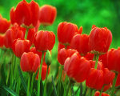
Спасибо за внимание! Thank you for your attention! Презентацию подготовила Юнусова наиля исмагиловна, преподаватель английского языка

