Slide 1
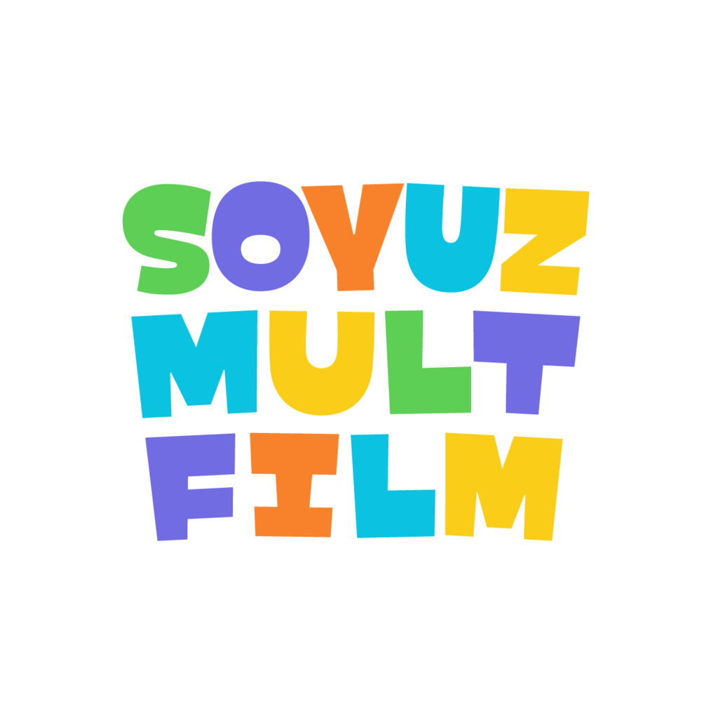
SOYUZMULTFILM
ВЫПОЛНИЛ ЛУЦЕНКО ДМИТРИЙ 8В

Slide 2
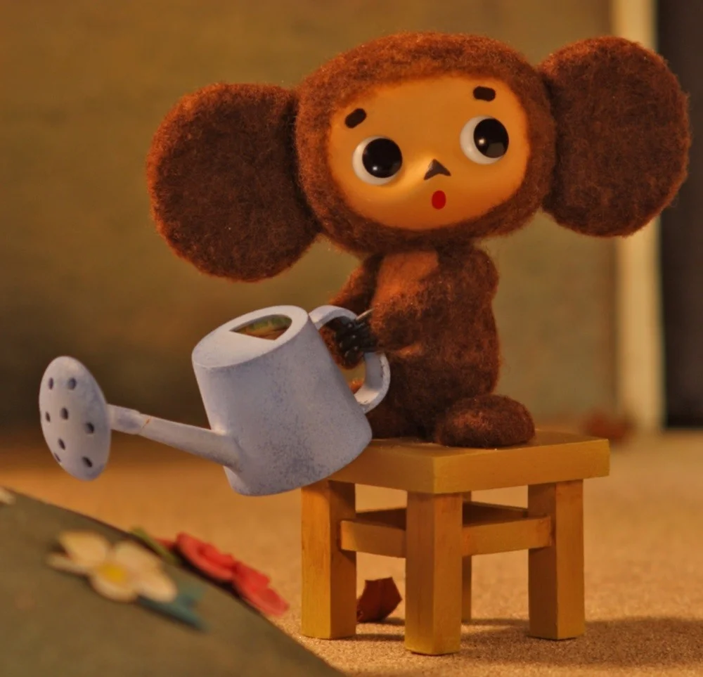
Soyuzmultfilm
SOYUZMULTFILM is a Russian animation studio based in Moscow. Launched in 1936, the studio has produced more than 1,500 cartoons. Soyuzmultfilm specializes in the creation of animated TV series, feature films and short films.

Slide 3
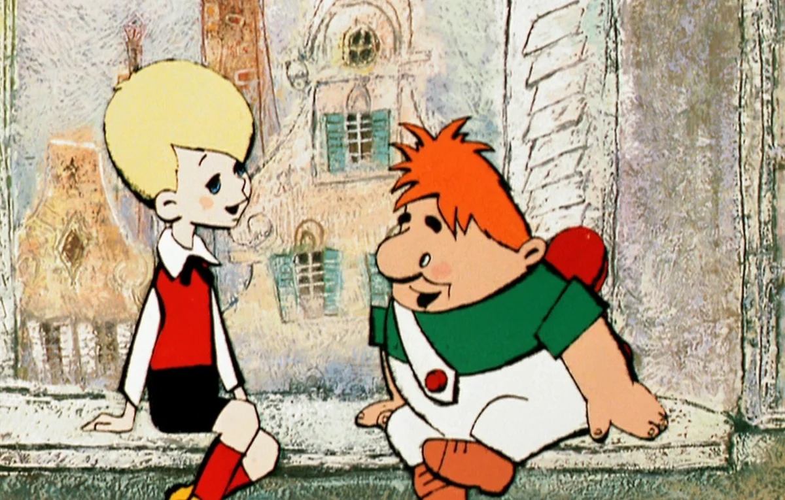
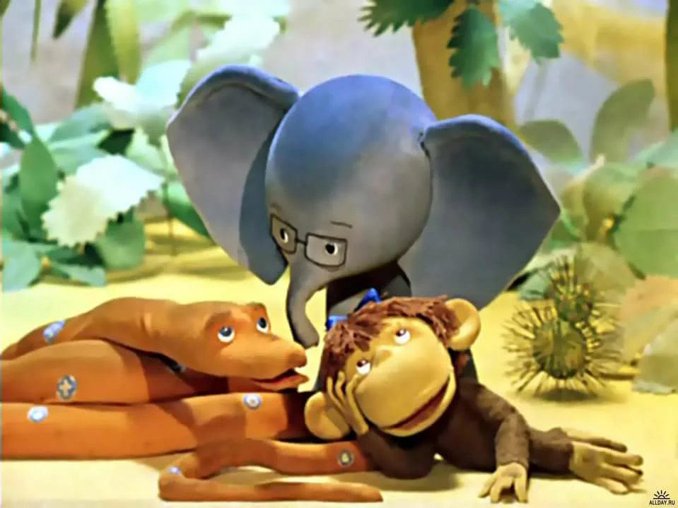
SOYUZMULTFILM
The "Golden Collection" of Soyuzmultfim, produced from the beginning of the 1950s and to the end of the 1980s, is considered to be the classics of the animation genre and the best works of world-renowned directors, production designers and animators. Among the studio's best-known films are Hedgehog in The Fog" (1975), Cheburashka series (1969–1983), I'll Get You! series (since 1969), Karlsson-on-the-Roof (1968) and others.

Slide 4
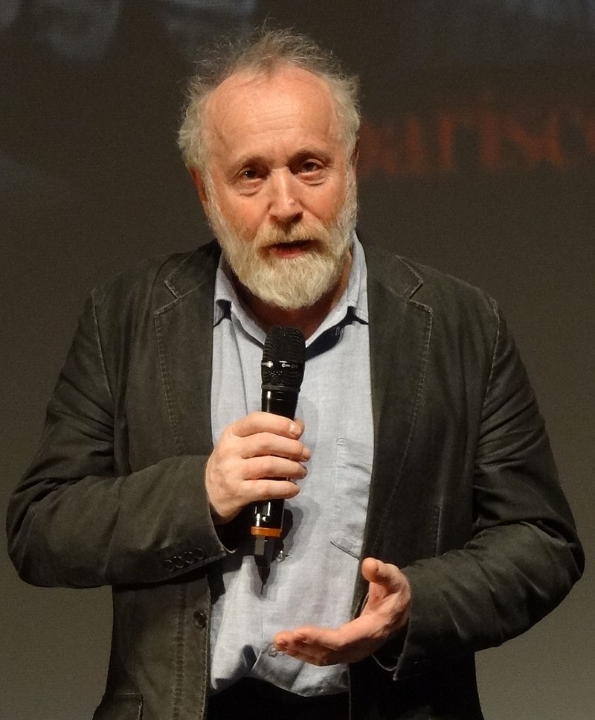
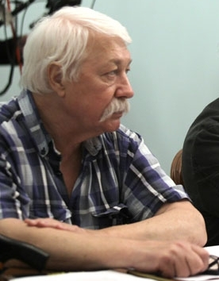
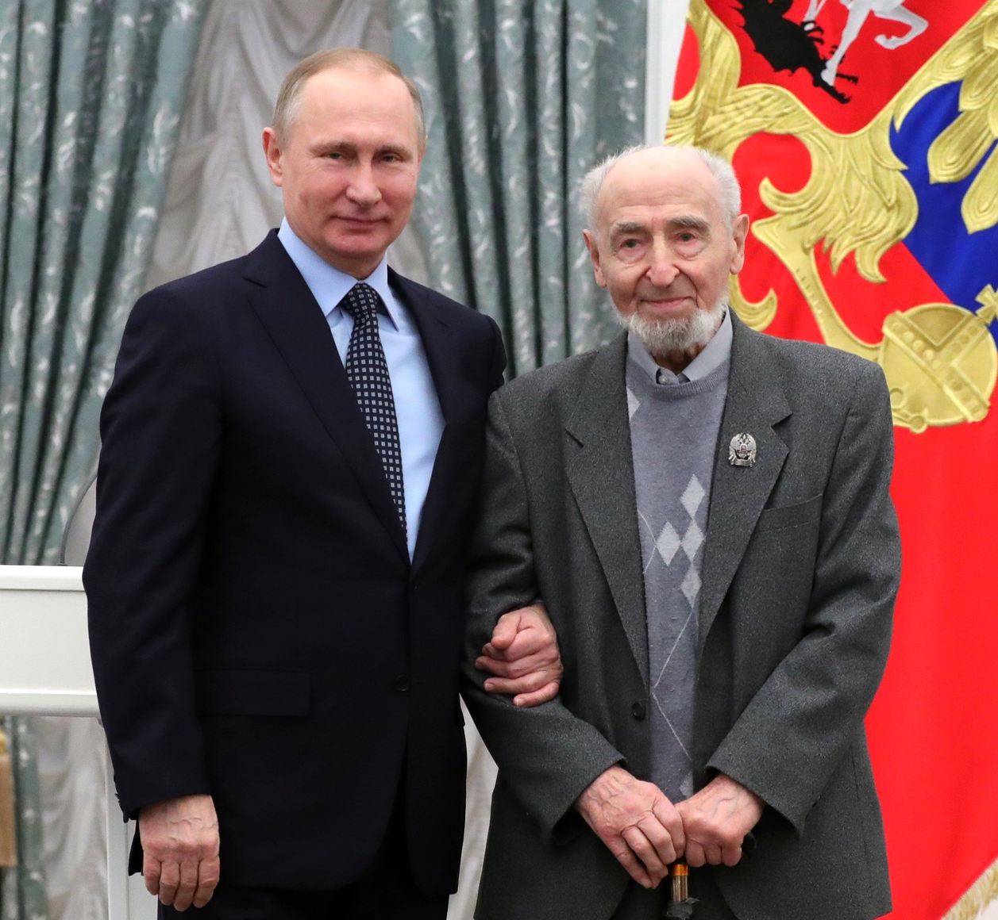
SOYUZMULTFILM
In the Studio worked such recognized masters of animation as People’s artist of Russia Yuriy Norstein (Hedgehog in the Fog, The Fox and the Hare), Leonid Shvartsman (Cheburashka, 38 Parrots), People’s artist of Russia Eduard Nazarov (Winnie-the-Pooh, Once Upon a Dog)

Slide 5
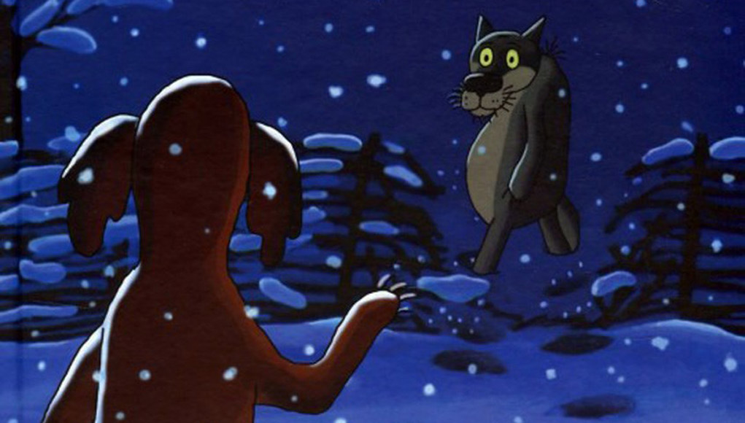
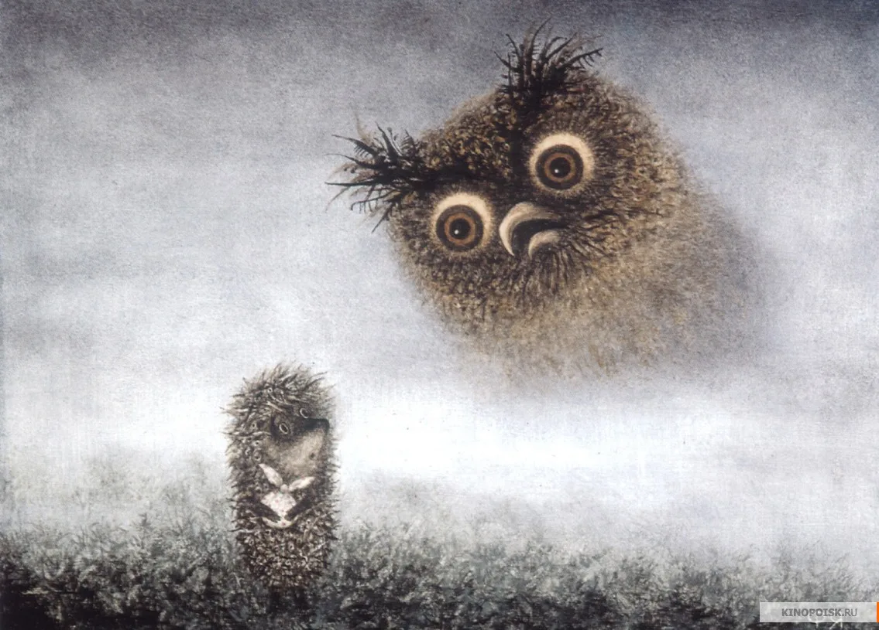
SOYUZMULTFILM
Many of the films rank among the classics of world animation, garnered a multitude of international and Russian awards and prizes, and became an integral part of Russian and global culture.

