Slide 1
Thursday, The 23d of February
Make the compliment!

Slide 2
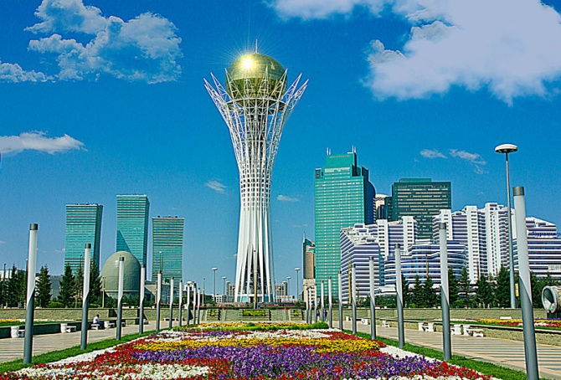
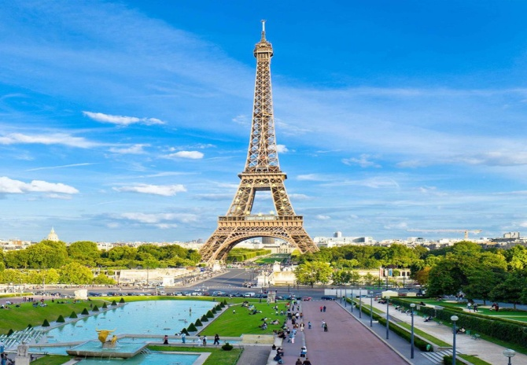
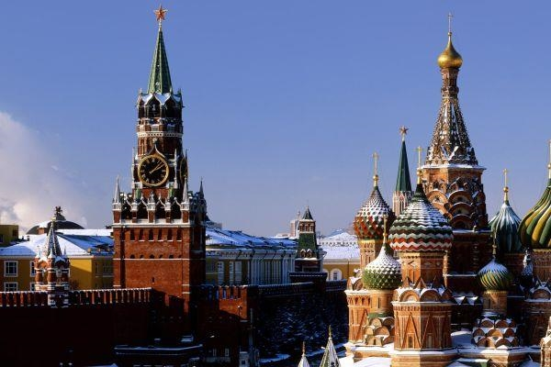
Is in
Paris
Baiterek
Moscow
Eifel tower
Kremlin
Astana

Slide 3
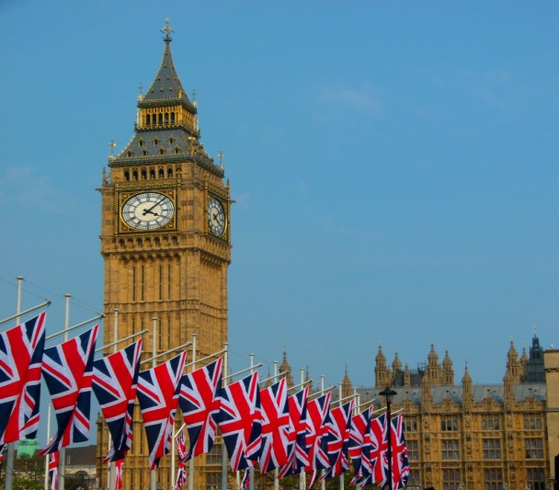
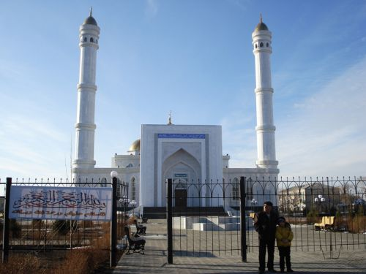
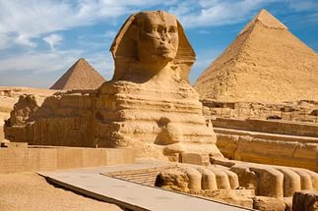
Is in
Karabalyk
Big Ben
Gashura Ana
Kairo
Sfinks
London

Slide 4
Check Home task
To__r
V__s__t
Tr__v__l___ng
Attr___ct
C___r___m___ny
ismtour
veltra
lacepa
neyjour
yagevo

Slide 5
Check up
Tour
Visit
Travelling
Attract
Ceremony
Tourism
Travel
Palace
Journey
Voyage

Slide 6
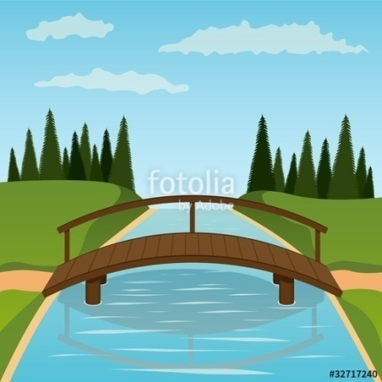
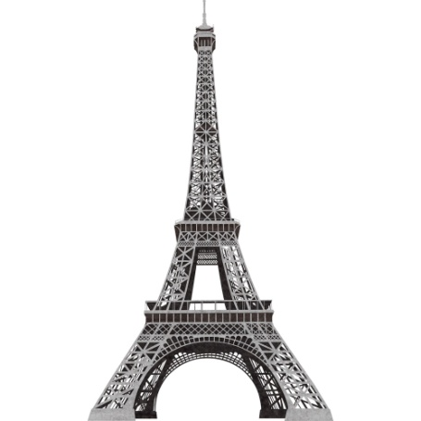
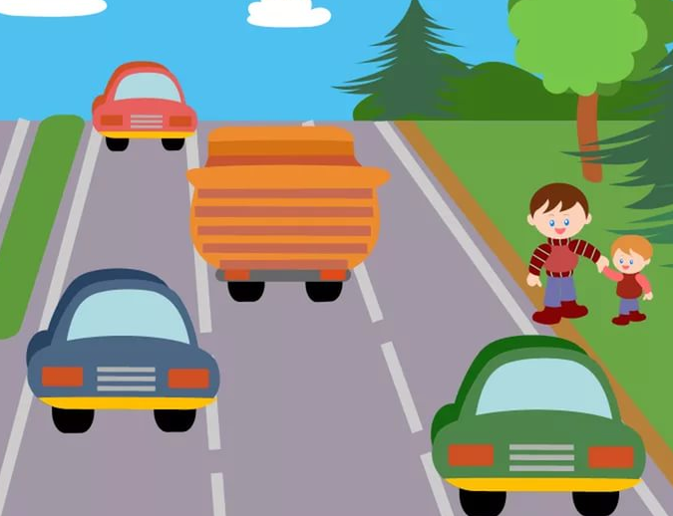
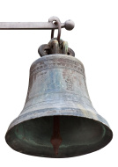
New words
1
1. A tourist [tǝurist]
2. A bridge [bridg]
3. A tower [tǝuǝ]
4. A traffic [træfik]
5. A bell [bel]
2
3
4
5

Slide 7
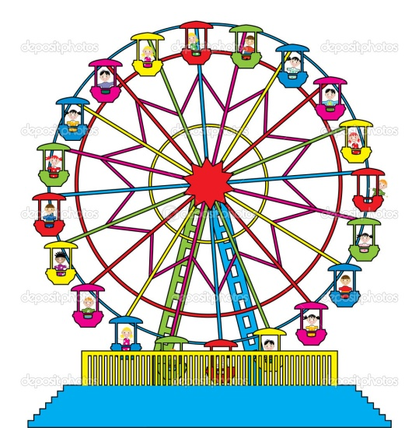
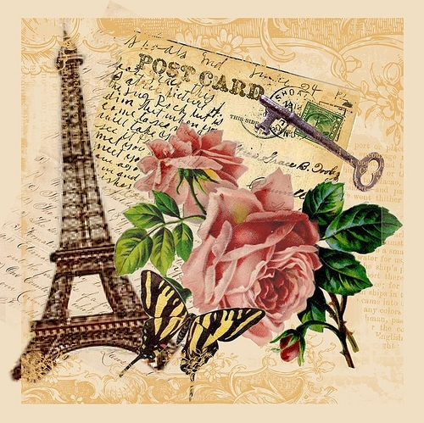
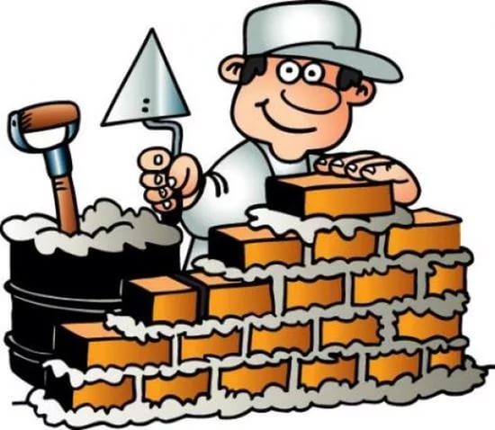
6
6.A wheel [wi:l]
7. A view [vju:]- вид
8. A postcard [pϽstka:d]
9. To build [bild]
10. To call [kϽl]
8
10
9

Slide 8
вид

Slide 9
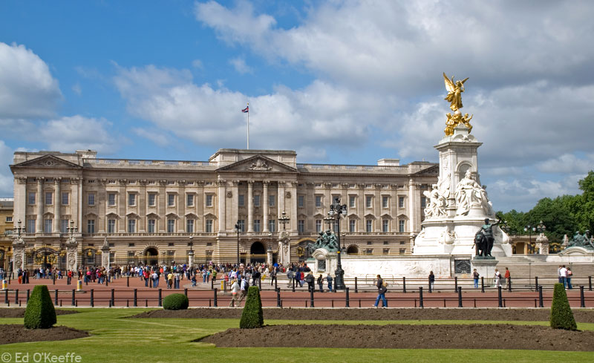
Audition: Buckingham Palace
Trafalgar Square
Queen Victoria
Queen Elizabeth II
British monarch

Slide 10
Audition tasks
Task 2: Complete the sentences
1) Buckingham Palace is the official residence of the British monarch in London.
2) Queen Victoria was the first monarch who lived in the palace.
3) It is big palace.
4) Buckingham Palace has 600 rooms.
5) About 50 000 guests visit Buckingham palace.

Slide 11
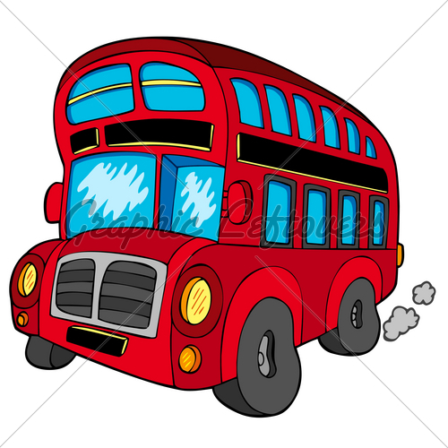
Relax pause

Slide 12
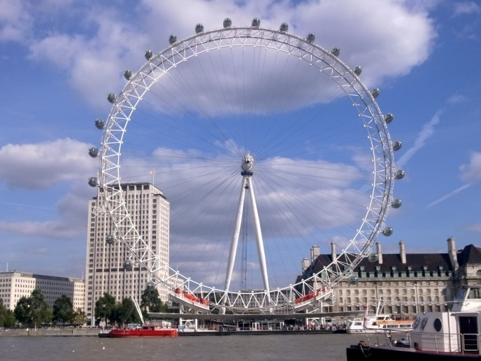
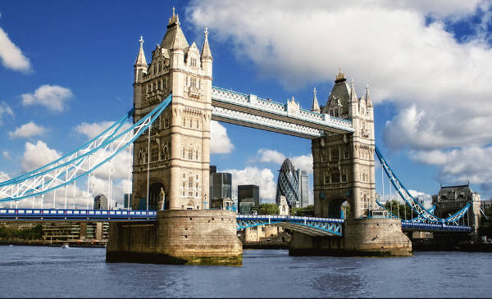
Reading prospects
Big Ben
London Eye
Tower Bridge
Thames
Architect

Slide 13
«Yes - No» questions
1) Big Ben is the bell of the clock, isn’t it? YES-NO
2) Big Ben was named after Sir Bred Pitt, wasn’t it? YES-NO
3) The London Eye is the biggest wheel in Britain, isn’t it? YES-NO
4) The London Eye was the emblem of computer, wasn’t it? YES-NO
5) The bridge is for the traffic, isn’t it? YES-NO

Slide 14
Make the project “POSTCARD”
Criteria of evaluation
Be in time – 3-5 minutes
View of postcard
Useful information
Max point - 5

Slide 15
Useful phrases:
Our postcard is about ___________
It is _________________
It has _________________

Slide 16
Test
Check yourself!!!

Slide 17
Variant I
A
B
C
C
B
Variant II
A
B
B
C
A

Slide 18
Total mark
25 – 22 – Very nice job! – “5”
17 – 21 – Good job! - “4”
less 17 – Try better! – “3”

Slide 19
THANK YOU FOR THE LESSON!

