Slide 1
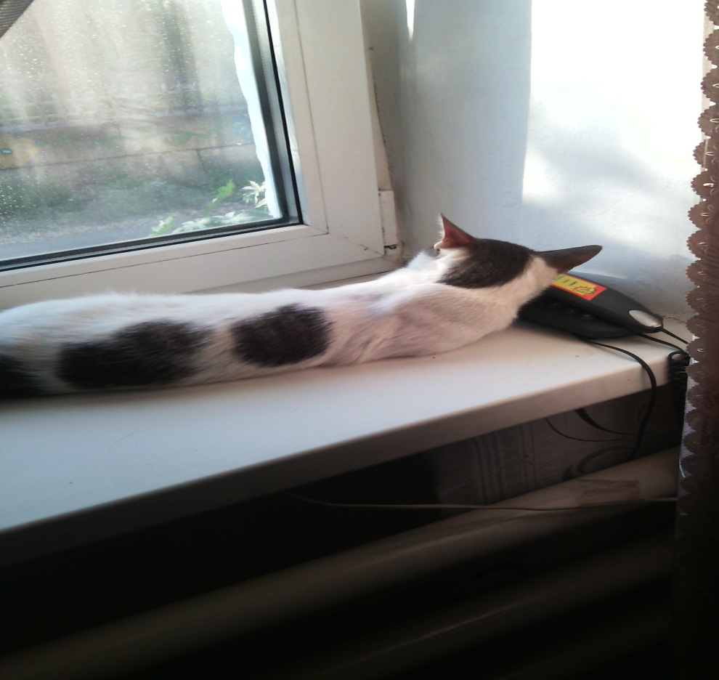
My favorite animals/ Мое любимое животное
I would like to tell the story about my cat. My cat is small,he is Belik. My cat is very playful . It is almost all white and black. Hе likes to sleep on the window. His eyes are green. Also Belik likes go for a walk very much. And when he sleeps he puts his head on the phone or a pillow.
/The End\

