Slide 1
The house of my dreams
Сделал: Нищерет Владислав 6-б класса

Slide 2
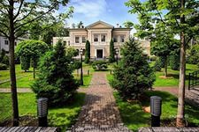
the house which I would like

Slide 3
description
This house is not only beautiful from outside but also inside . Inside there are beautiful paintings and road furniture, beautiful kitchen

