Slide 1
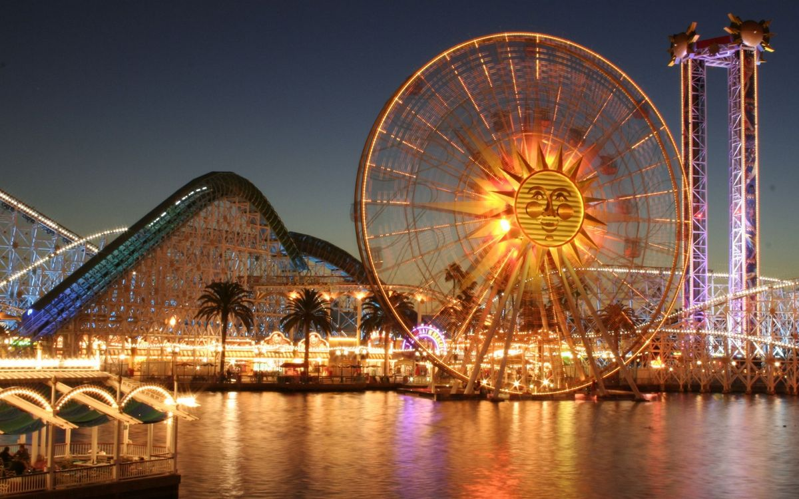
At the fair
Саломатова Наталья Виталиевна
МОУ «СОШ № 24»
Копейского городского округа

Slide 2
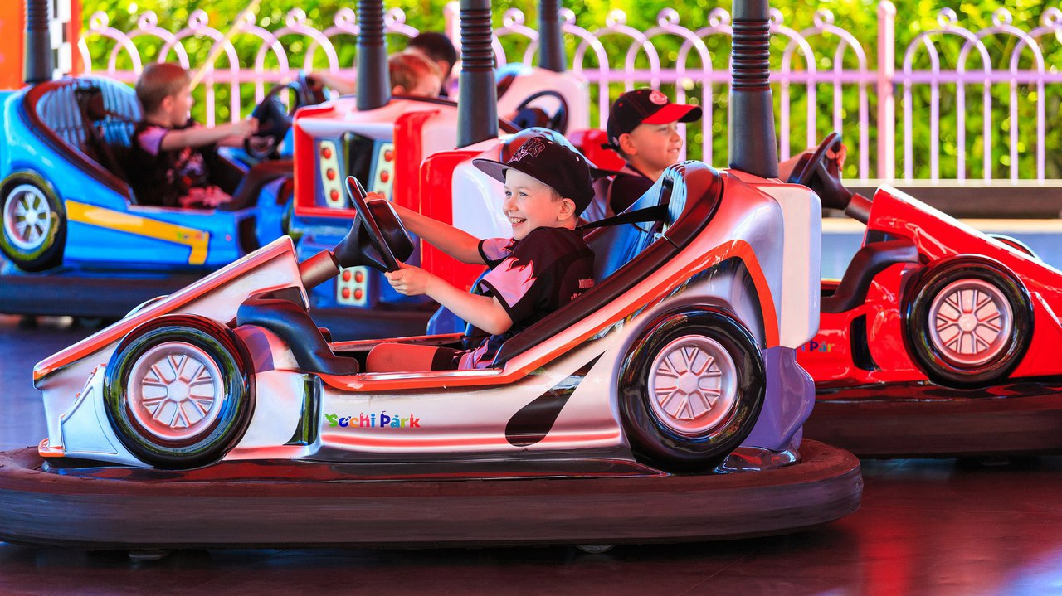
Ghost train
dodgems

Slide 3
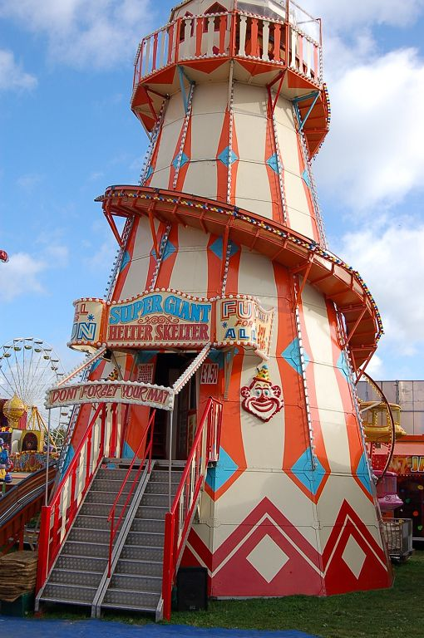
Roller coaster
Helter-skelter

Slide 4
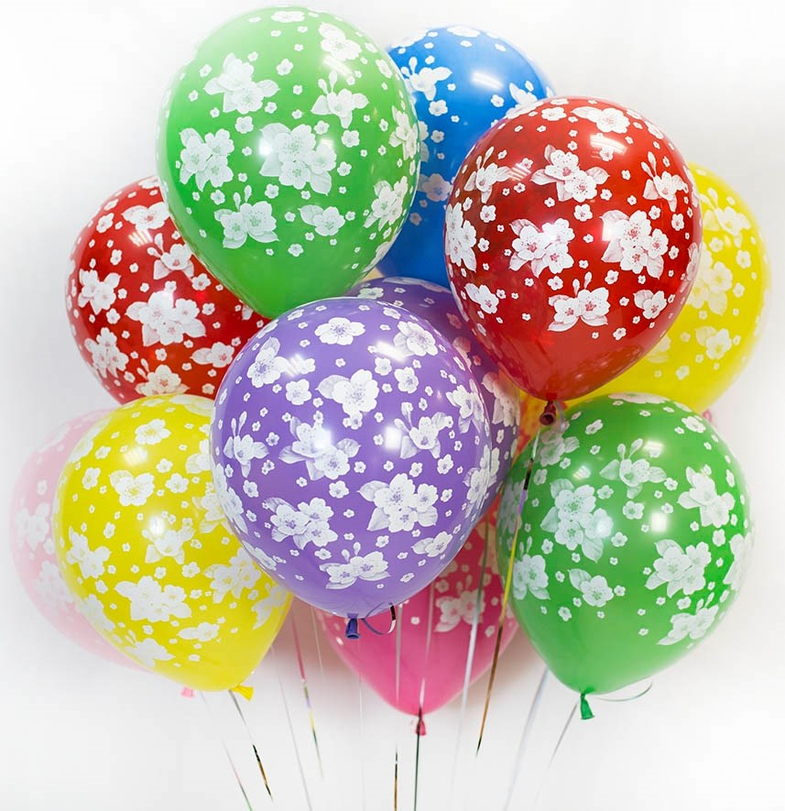
Candy floss
baloons

Slide 5
Make your own sentences
I like…
I don’t like…
It is a …

Slide 6
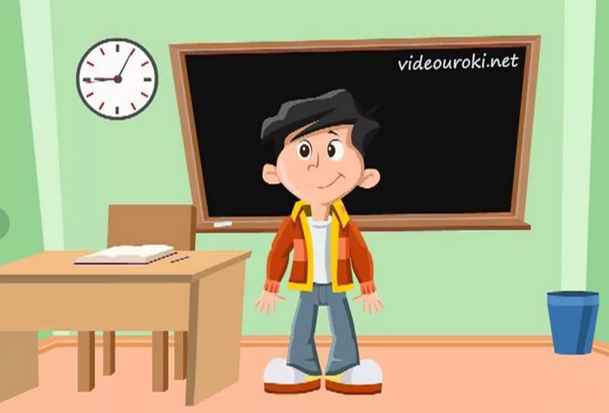
It’s time to relax)))

Slide 7
Answer the questions
1. Who wants to go on the dodgems? –
Ben.
2. Who wants to have some candy floss? –
Sally.
3. Who wants to go on the ghost train? –
Mary.
4. Who wants another burger? –
Eddy.

Slide 8
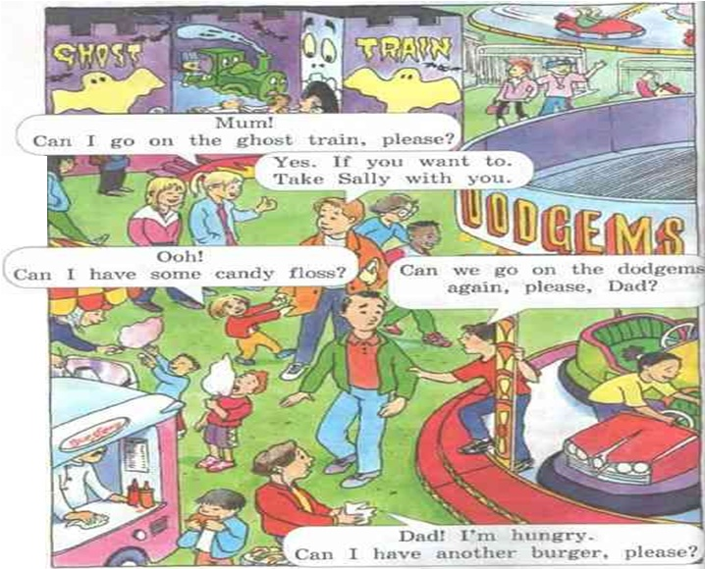
Let’s play

Slide 9
Home task
P. 8 - learn new words
Make a crossword with them

Slide 10
Reflecton
Работа с текстом
Работа со слайдами
Физминутка

