Slide 2
It’s fun to learn English!
It’s fun
to learn
English!
It

Slide 3
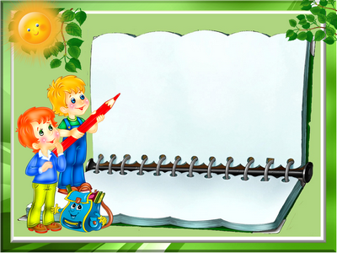
Invisible words Цель: нарисовать в воздухе загаданное слово. Задача
остальных игроков – угадать слово
Invisible words Цель: нарисовать в воздухе загаданное слово. Задача остальных игроков – угадать слово

Slide 4
Who knows more?
“Sport”
“Food”
“Clothes”
“Animal”

Slide 5
Captains
competition

Slide 6
The king would sing, about a ring
that would go ding.
Black bug bit a big black bear.
But where is the big black bear that
the big black bug bit?
The thirty-three thieves thought
that they thrilled the
throne throughout Thursday

Slide 7
Twelve twins twirled twelve twigs.
If a white chalk chalks on
a black blackboard, Will a black chalk
chalk on a white blackboard?
Betty and Bob brought back
blue balloons
from the big bazaar.

Slide 8
Who speaks
better?

Slide 9
Creative Task

Slide 10
Home
task

Slide 11
Thanks for your
attention!
Good bye!

