Slide 1
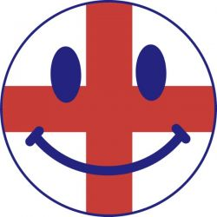
______, My ______ WHAT have I done for you, ______, my ______? What is there I would not do, ______, my own? With your glorious eyes austere, As the Lord were walking near, Whispering terrible things and dear As the Song on your bugles blown, ______-- Round the world on your bugles blown!
by William Ernest Henley
Austere-суровый
Bugle-рог

Slide 2
England, My England WHAT have I done for you, England, my England? What is there I would not do, England, my own? With your glorious eyes austere, As the Lord were walking near, Whispering terrible things and dear As the Song on your bugles blown, England -- Round the world on your bugles blown!
Austere-суровый
Bugle-рог

Slide 3
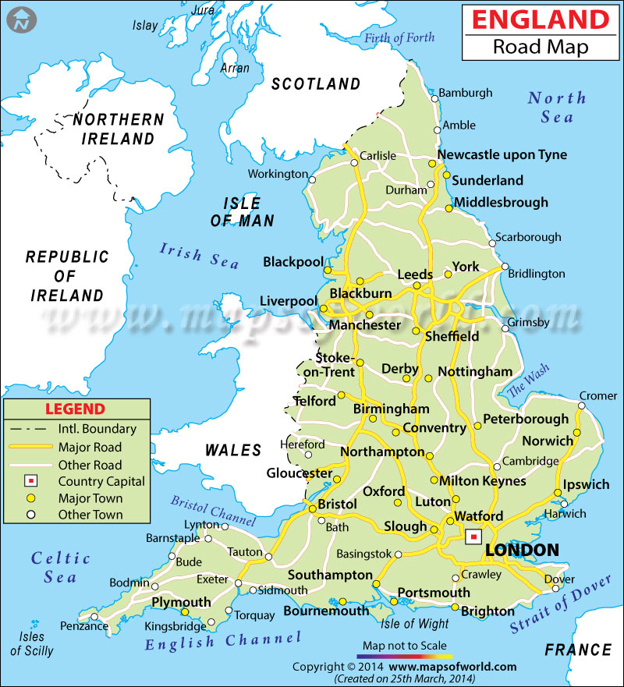

Slide 4
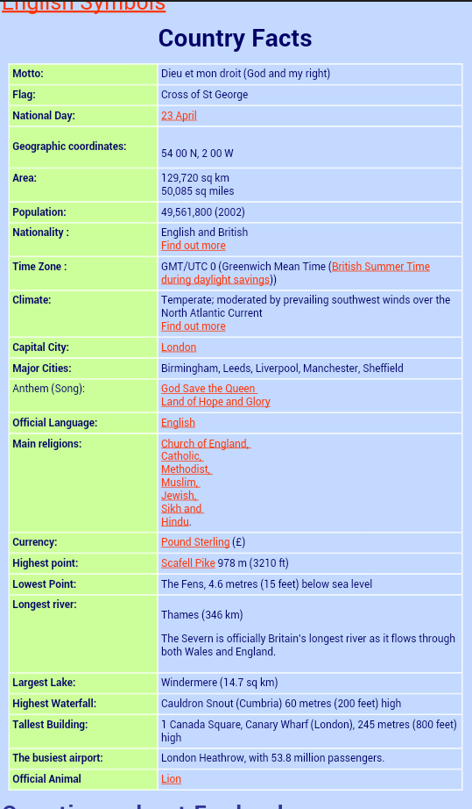

Slide 6
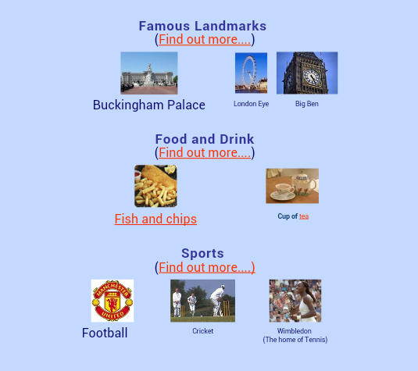

Slide 7
England is the most populated country in the United Kingdom. The other countries that make up the United Kingdom are Wales, Scotland and Northern Ireland.
England is bordered by Wales to the west and Scotland to the north.
The population of England in 2011 was around 53 million.
The capital city of England is London. Other major cities include Birmingham, Manchester, Sheffield, Liverpool, Newcastle and Leeds.
England includes many small islands such as the Isle of Wight and Hayling Island.
There is only a 34 kilometre (21 mile) gap between England and France and the countries are connected by the Channel Tunnel which opened in 1994.
England was the first industrialized nation after the industrial revolution that began around 1760.
Famous English scientists include Charles Darwin, Michael Faraday, Isaac Newton and Stephen Hawking among many others.

Slide 8
The longest river in the United Kingdom is the River Severn. Located in England and Wales, it stretches around 354 kilometres (220 miles) in length.
The longest river found entirely in England is the River Thames, it flows through London and is slightly shorter than the River Severn at around 346 kilometres (215 miles) in length.
The largest lake in England is named Windermere.
The highest mountain in England is Scafell Pike, which stands at around 978 metres (3,209 ft) in height.
England has a large economy and uses the pound sterling as its currency.
English computer scientist Tim Berners-Lee is credited with inventing the World Wide Web.
There have been a number of influential English authors but perhaps the most well known is William Shakespeare, who wrote classics such as Romeo and Juliet, Macbeth and Hamlet.
Football (soccer) is the most popular sport in England but others such as cricket and rugby have large followings.
The Summer Olympic Games have been held in London 3 times, in 1908, 1948 and 2012.
The official London home of the British monarch (king or queen) is Buckingham Palace.

