Slide 1
The progressive methods helping to study of English Language

Slide 2
Objective of the project: to learn new modern methods of studying the English Language

Slide 3
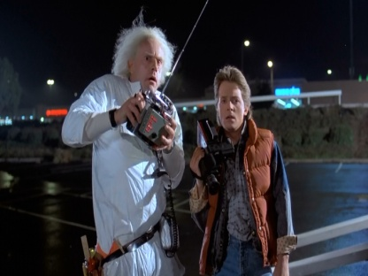
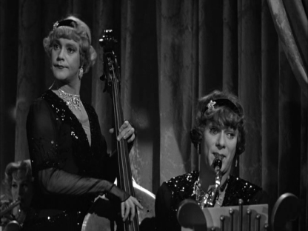
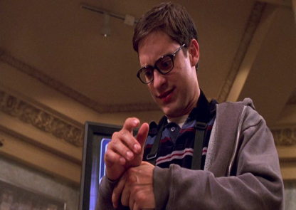
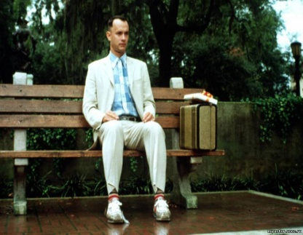
Any studying the English language dreams to listen to any song of English-speaking singers and understand all beauty of the art text without translation. And who doesn`t dream of watching favorite films in English? ☺

Slide 4
It`s not very complicated especially if you have enough motivation, show patience to studying the English language

Slide 5
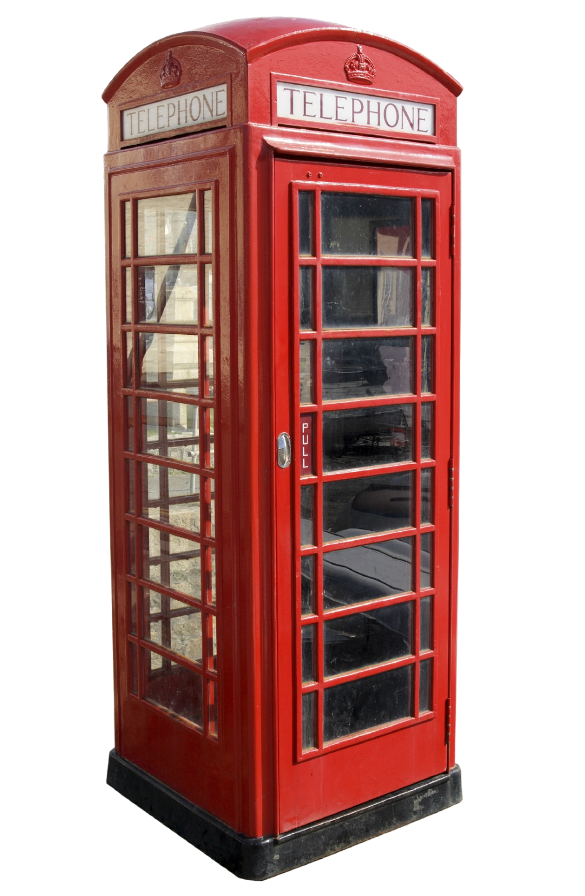
Horizons of your vision become wider, the curtain will be slightly opened for the huge fine world when you seize by new skill. It is how you see the world in colours.

Slide 6
Books of such wonderful authors as Ernest Miller Hemingway, Somerset Maugham and many others in the original, we think, are much better than any translation which can not express all beauty and subtlety of the original.

Slide 7
It is not a secret that words and word-combinations are a base of language. Connecting word in a string of phrases, we express our thoughts. Learning of words separately from a context is ineffective.

Slide 8
What techniques of learning words and word-combinations are exist?

Slide 9
The first: English in pictures!
You draw words on a paper and they will be remembered much easier. Provided that you draw them by yourself! Place the pictures along the apartment and that`s all! You will see, the result will not keep itself waiting long!

Slide 10
This technique is suited both types of people : visual and audiblers. In such a way it is possible to remember a lot of words. Especially if these words are taken from your favourite songs!

Slide 11
The second: English songs!
It is very important that songs should be pleasant and provide positive emotions. Words and word- combinations are remembered in a context. They are easily stored in memory with idiomatic expressions (phraseology units). It`s necessary to print only the text, to study the translation and sing!

Slide 12
The third: Watching movies!
It is rather powerful tool in studying English! You plunge into the natural language environment absorbing speech of native speakers. Both channels of perception like sounds and pictures are involved in studying process. There is a great bonus! It`s one of the most enjoyable methods of learning English.
Rather important remark. A movie should be interesting and willing to have English subtitles with Russian line of translation. It`s better to watch the movie by parts repeating the words together with movie heroes.
Storing words and word-combinations happens easily! There is an immersing in the natural language environment. Accustoming to English speech.

Slide 13
When you come closer to your perfect English the next step will be reading English texts in original! Usual reading gives huge difficulties in learning English. Translation of each word with a vocabulary is not easy.

Slide 14
Parallel texts have come to help us! A text is divided in two parallel parts. In the left part – English text with Russian explanations. In the right part – an original English text.

Slide 15
Reading English sentences in the right column, we try to understand the meaning. Then we check again using the left column. What have you understood? The powerful method!

Slide 16
We have decided to lead three lessons using all technics for revealing their efficiency. For our work we’ve taken the lovely song «Let it be», our favourite film «Back to the Future» and an interesting text. The results have amazed!!!

Slide 17
The words, word-combinations and idiomatic units were postponed in our heads automatically! We were singing, watching and reading with great pleasure! All our classmates have noted that all these methods of learning English are not only very interesting but very effective and motivate for studying!

Slide 18
We have carred out some statistic . We have asked our classmates how they learn English? We find out that 46%- listen to English songs.18%-watch films.14% -tried to use pictures. 16%- like to use parallel texts .4%- tried to read books and 2% doesn`t do English well.

Slide 19
Thus, we have considered many options of studying English language and each of them for its own good. And we are sure that you will be able to choose the method that is right for you!

Slide 20
Motivation, passionate desire and faith in yourself are three components of your success in learning English language!

Slide 21
Thank you for attention!

