Slide 1
My presentatoin «Famous people»

Slide 2
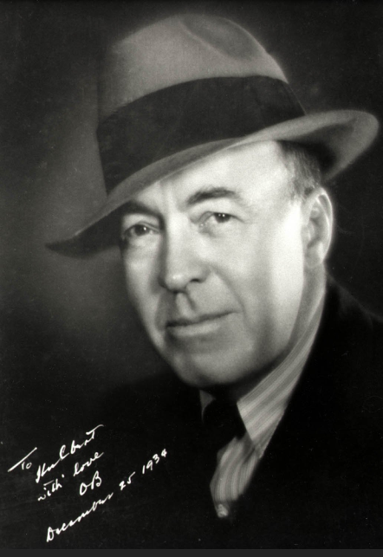
Edgar Rice Burroughs

Slide 3
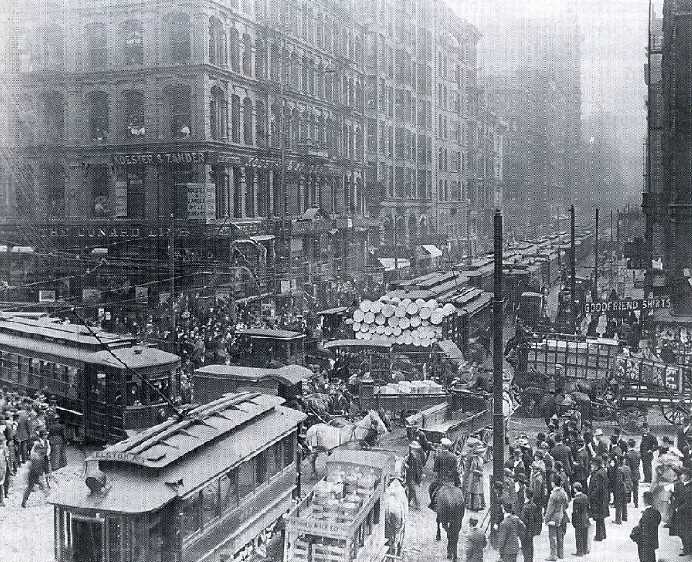
Edgar Rice Burroughs was born in Chicago, USA in 1875.

Slide 4
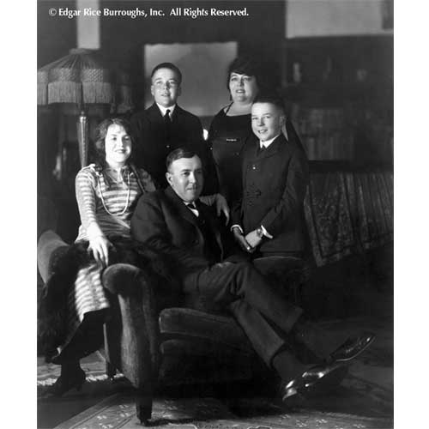
IIn family of George Burroughs and Mary Evalayn Saiger.

Slide 5
He was fourth son in the family. He had family in 1900. His wife had name Emma Centania of the Hulbert.

Slide 6
He studied in school`s Brown. Then he studied in school`s Malpetuso for girls. Then he studied in school`s Endvitsky.

Slide 7
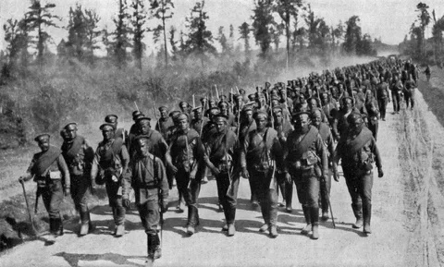
Then he was in army. But thorough 10 moths he left army.

Slide 8
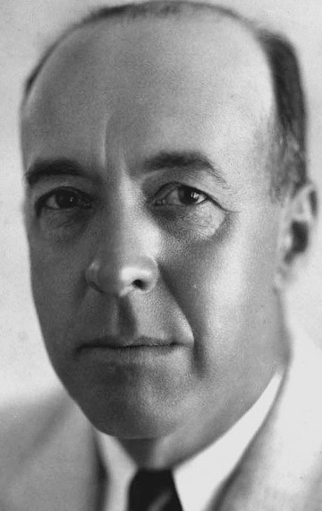
Then he became a writer.

Slide 9
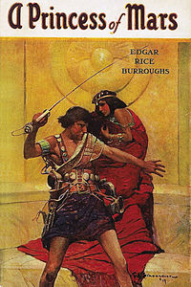
He wrote «Under the Moons of Mars», «Tarzan off the Apes», «John Carter».

Slide 10
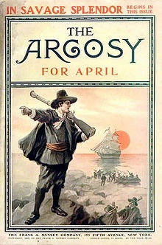
His works were in Pulp magazines. His alias was «Normal Bean», but in the magazines «Norman Bean» was written. Then he had company`s Edgar Rice Burrough , Ins.

Slide 11
I like book`s «Tarzan of the Apes». This is very interesting adventure about one man.

Slide 12
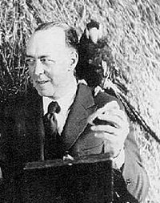
This is very popular writer and in our days. Презентация Котлярова Григория 7В класса

