Slide 1
Birds, animals and plants on the coats of arms of Russian Far East cities
Made by DMITRII LUTSENKO © 2019

Slide 2
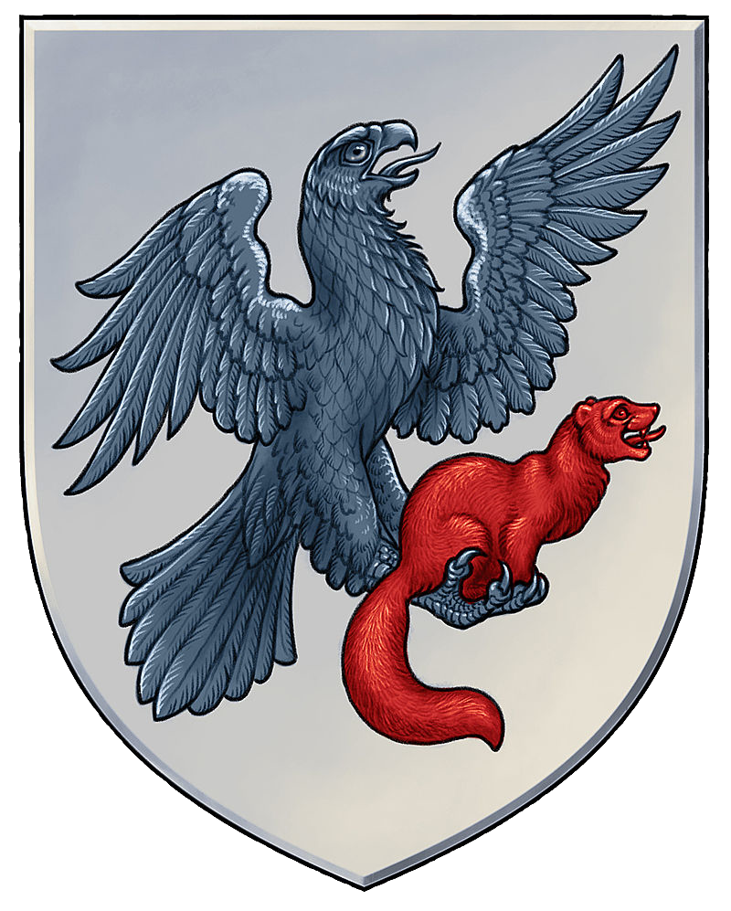
YAKUTSK.
In the silver field is a black eagle
supporting a red sable. Sable indicates the natural wealth of the Yakut land.

Slide 3
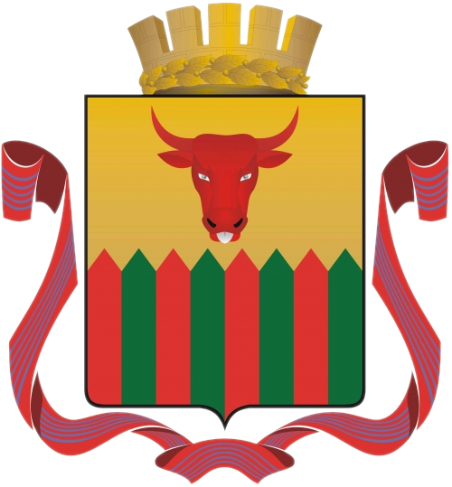
CHITA.
In the Golden field is a red-green fence
accompanied at the top by a red Buffalo head
with silver eyes and tongue.
The shield is crowned with a Golden crown
surrounded by a Golden Laurel wreath and entwined with a ribbon of the order of the October Revolution
Buffalo head means the traditional occupation of cattle breeding of the Chita people

Slide 4
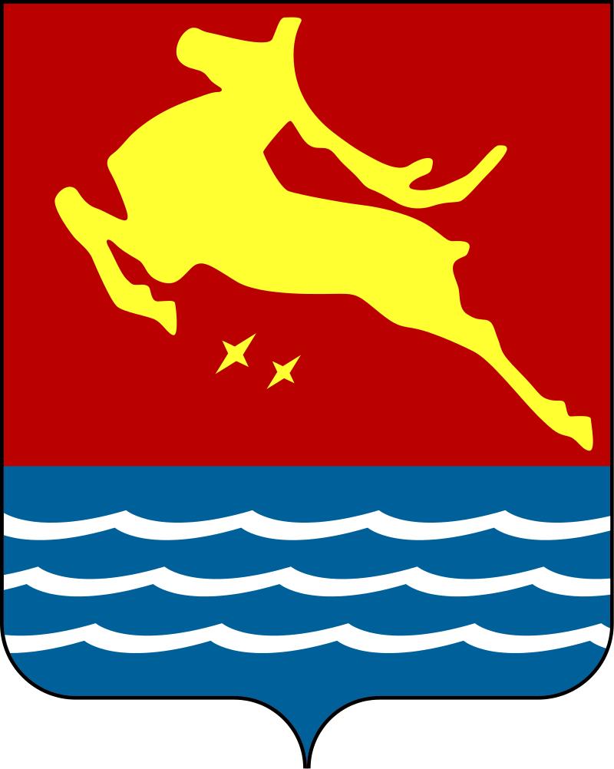
MAGADAN.
In the center of the red stripe is depicted a Golden deer,
representing at the same time the
two main sectors of the economy of the Magadan region
— gold mining and reindeer husbandry.

Slide 5
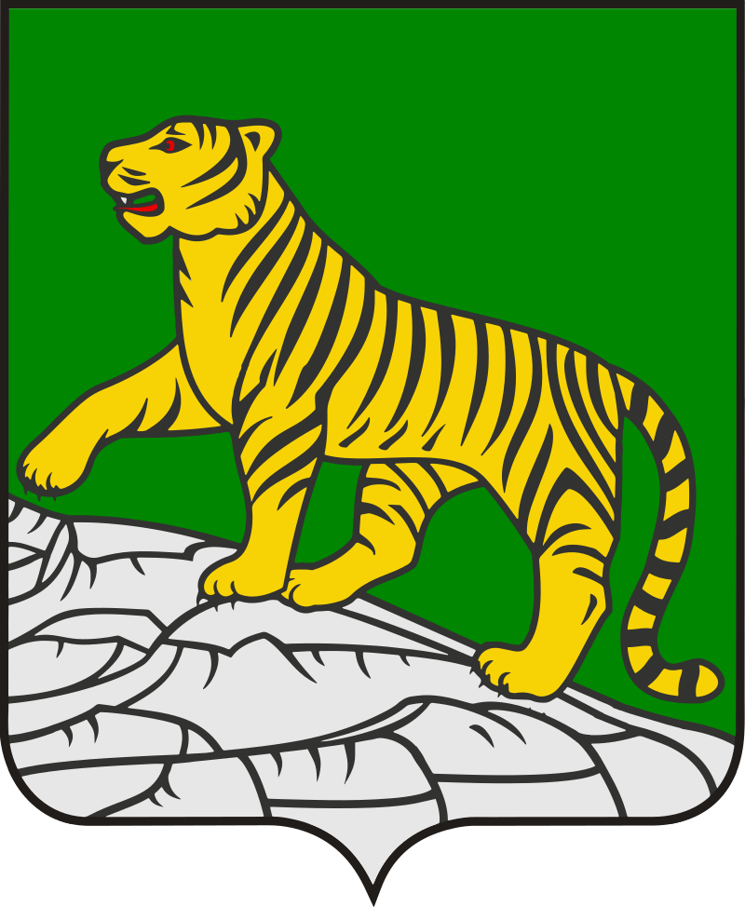
VLADIVOSTOK
In the green field of the
shield is a Golden tiger with
red eyes and tongue,
walking on a rocky slope

Slide 6
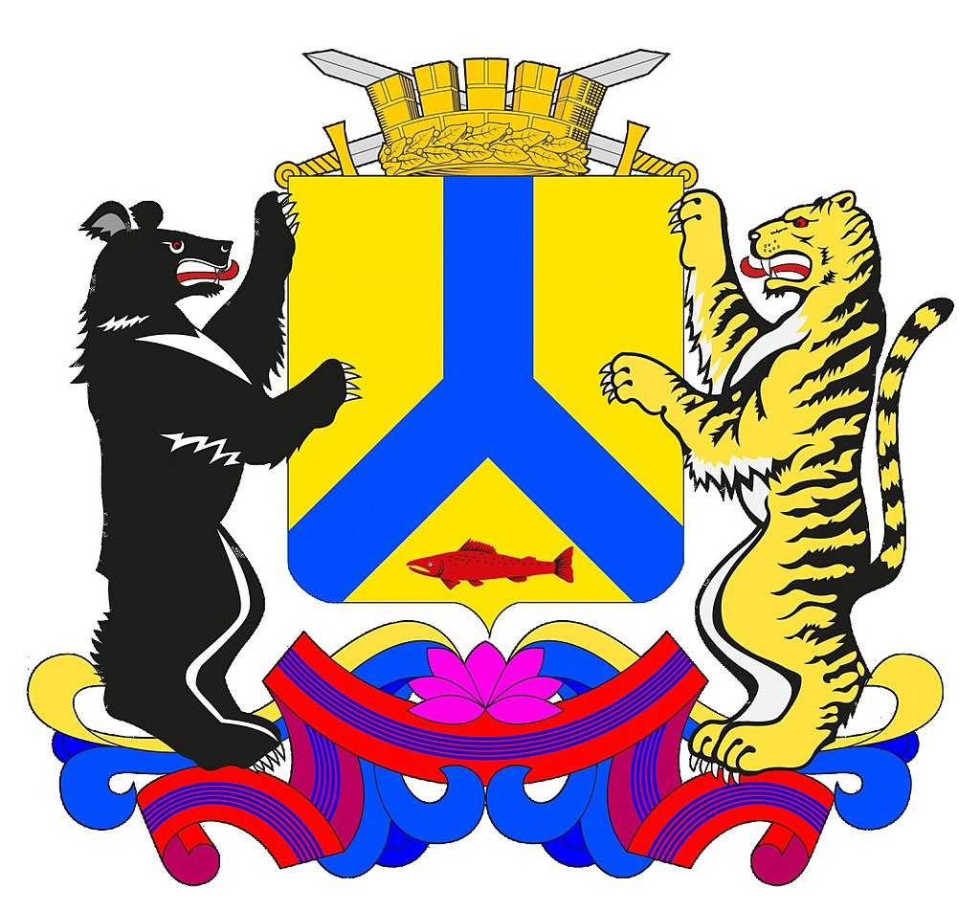
KHABAROVSK.
In the blue-gold field red fish-sturgeon.
The shield surmounted by a crown .
Shield-holders - black with silver
breast and claws, red eyes and tongue
Himalayan bear and gold with
silver breast and claws,
red eyes and tongue Amur tiger.

Slide 7
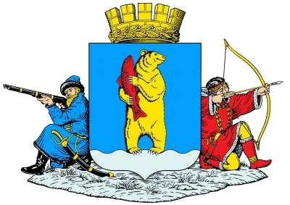
ANADYR.
In the blue shield is a Golden smiling bear with silver claws holding a red fish in a pole on the right. The brown bear symbolizes the power of Russia, as well as the rich natural environment of Chukotka. The fish in the bear's paws denotes Anadyr as the center of fish production.

