Slide 1
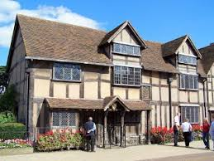
Revision. Lesson 10.

Slide 2
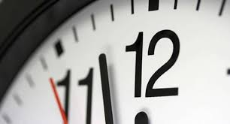
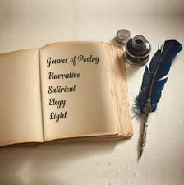
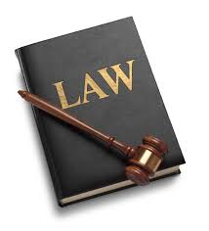
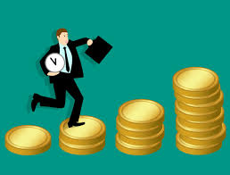
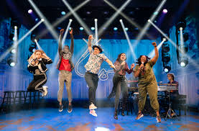
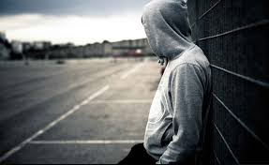
I. Vocabulary.
To perform in a play or a film is to ….
Completely correct in every detail is …
The art of writing poems is ……
Someone who is involved in illegal activities is a ….
A rule that people in the country must obey is a …
To get money for the work you do is to …
Poetry, a criminal, to act, a law, to earn, exact.

Slide 3
II. Grammar.
Parents | want | …… | to ….
Teachers | expect | ……. | to …..
Pupils | would like | ………. | to …..
I | don’t want | ……… | to …..
Mother | wouldn’t like | ……… | to ……
Родители хотят, чтобы их дети приходили домой вовремя.
Учителя ожидают, что ученики будут много читать.
Ученики хотели бы, чтобы учителя были добрыми.
Я не хочу, чтобы она сделала ошибку.
Мама не хотела бы, чтобы я стал актером.

Slide 4
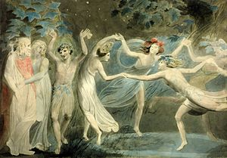
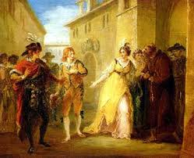
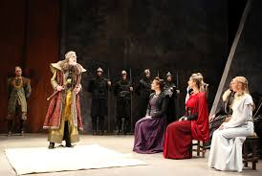
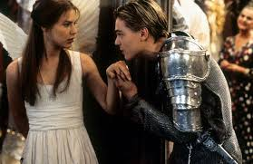
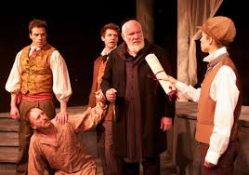
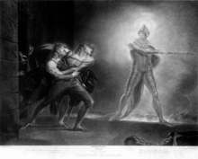
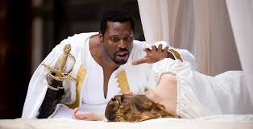
III. Shakespeare’s Plays.
1. The Twelfth Night. | А. Сон в летнюю ночь.
2. King Lear. | B. Отелло.
3. Romeo and Juliet. | C. Двенадцатая ночь.
4. Midsummer’s Night Dream. | D. Король Лир.
5. The Merchant of Venice. | E. Гамлет.
6. Hamlet. | F. Венецианский купец.
7. Othello. | G. Ромео и Джульетта.
Notes:
hakeaper

Slide 5
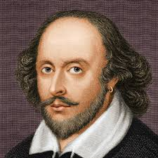
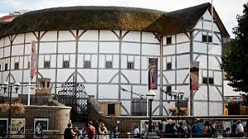
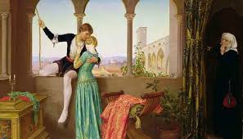
IV. Shakespeare’s Biography.
Shakespeare was born ….. A. March, 23, 1564 B. April, 23, 1564.
His father was ….. A. a doctor B. a glove-maker
He studied …. A. in a grammar school B. at university.
William had ….. A. two daughters. B. three daughters.
In 1587 Shakespeare went to …… A. Cambridge B. London.
There he began to act and to … A. write plays B. write sonnets.
Shakespeare died in 1616 in ……. A . London B. Stratford.
His plays are performed … A. only in Britain B. all over the world.

Slide 6
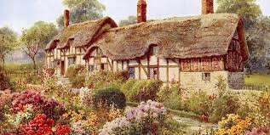
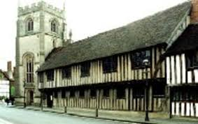
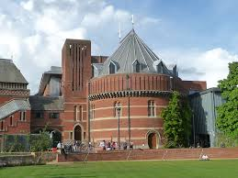
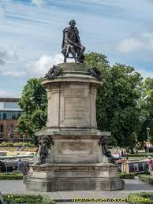
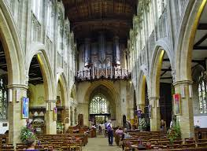
V. Shakespeare’s Places in Stratford.
a.
b.
c.
d.
A. The place where Will studied | 1. Anne Hathaway’s cottage | …..
B. Will’s birthplace | 2. A grammar school | ……
C. The memorial in the open air | 3.Shakespeare Theatre. | ……
D. His wife’s birthplace | 4. The Holy Trinity Church. | ……
E. You can enjoy his plays there. | 5. Henley Street. | …….
F. The place he was buried. | 6. The statue of Shakespeare | ……..
e.
f.

Slide 7
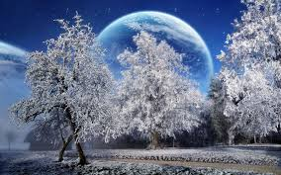
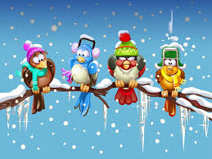
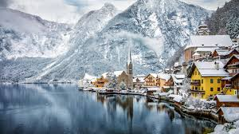
Thank you for attention.

