Slide 1
Good morning, good morning, good morning to you good morning, good morning, I am glad to see you.

Slide 2
Language Workout

Slide 3
Name the Country

Slide 4
Name the Country

Slide 5
Name the Country

Slide 6
Name the Country

Slide 7
Name the Country

Slide 8
Name the Country

Slide 9
Name the Country

Slide 10
Name the Country

Slide 11
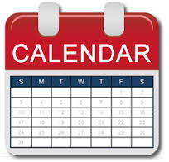
In What Month?
New Year holiday
Christmas day
Defender of the Fatherland Day
International Women's Day
National Flag Day
Spring and Labour Day
Victory Day
Russia Day
Unity Day
Maslenitsa

Slide 12
Maslenitsa

Slide 13
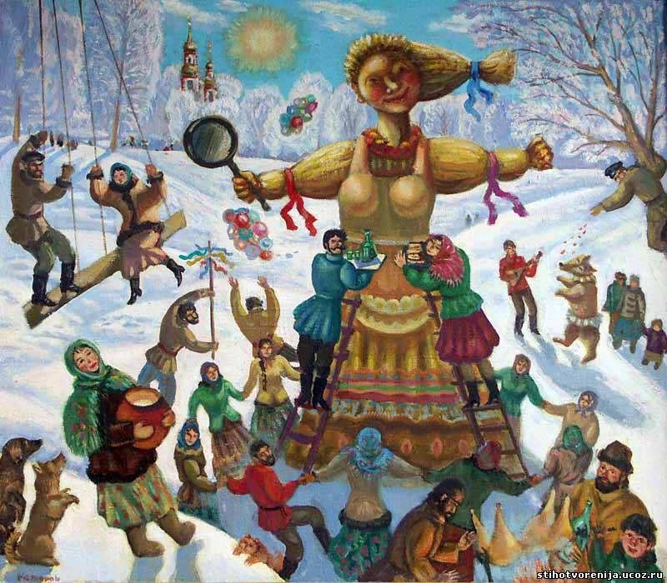
Group Projects:
1) Historians
2) Farmers
3) Cooks

Slide 14
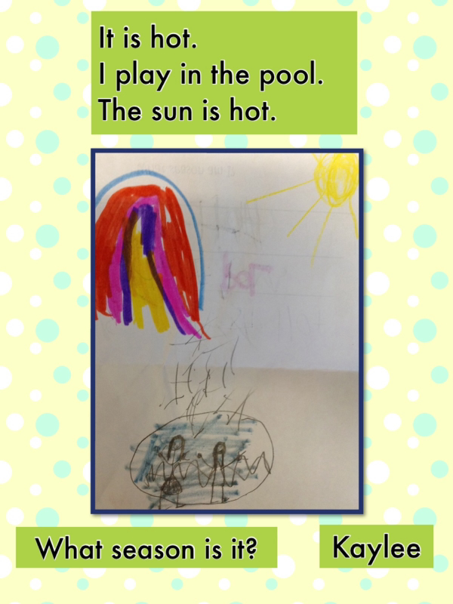
Riddle Time!

Slide 15
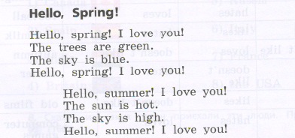
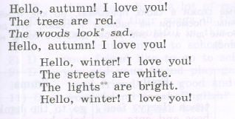
Let’s Read a Poem!

Slide 16
Bye-Bye!

