Slide 1
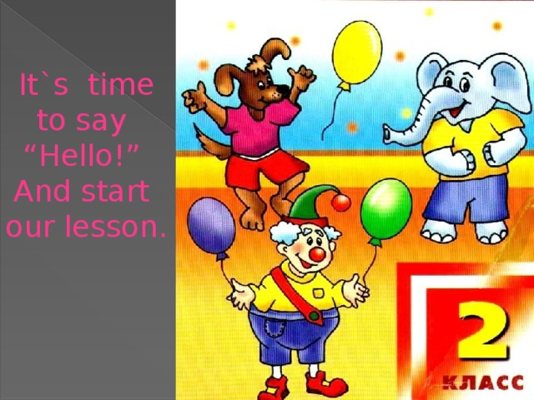

Slide 2


Slide 3
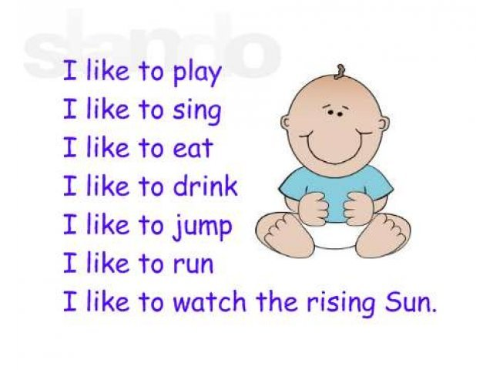
Речевая зарядка

Slide 4
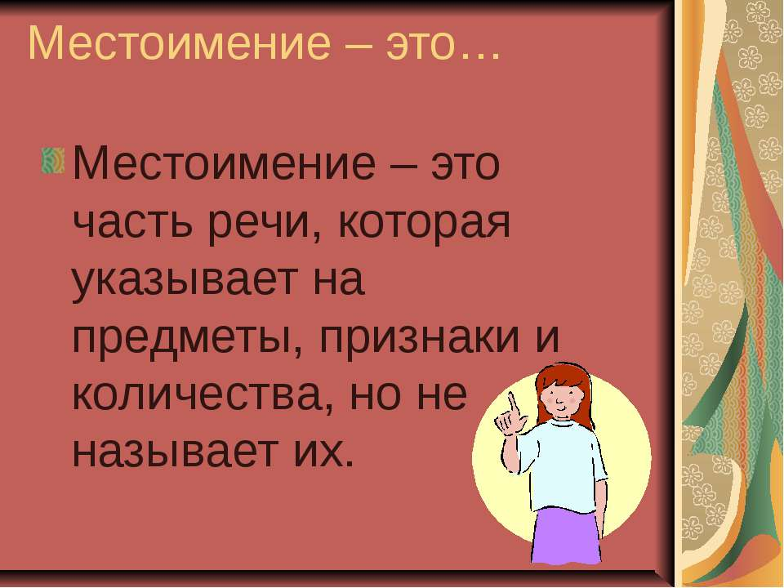

Slide 5
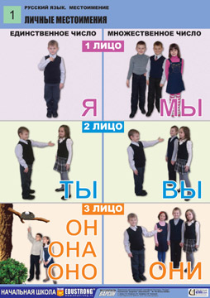
1 лицо
I
я

Slide 6
2 лицо
you
ты,

Slide 7
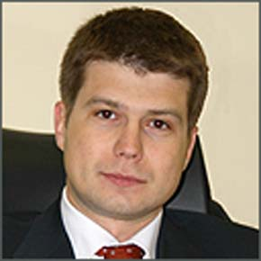
3 лицо
he
он

Slide 8
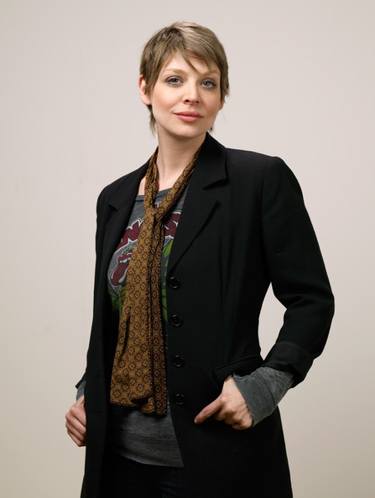
3 лицо
she
она

Slide 9

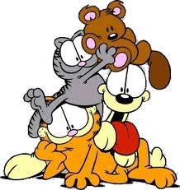
3 лицо
it
он, она, оно

Slide 10
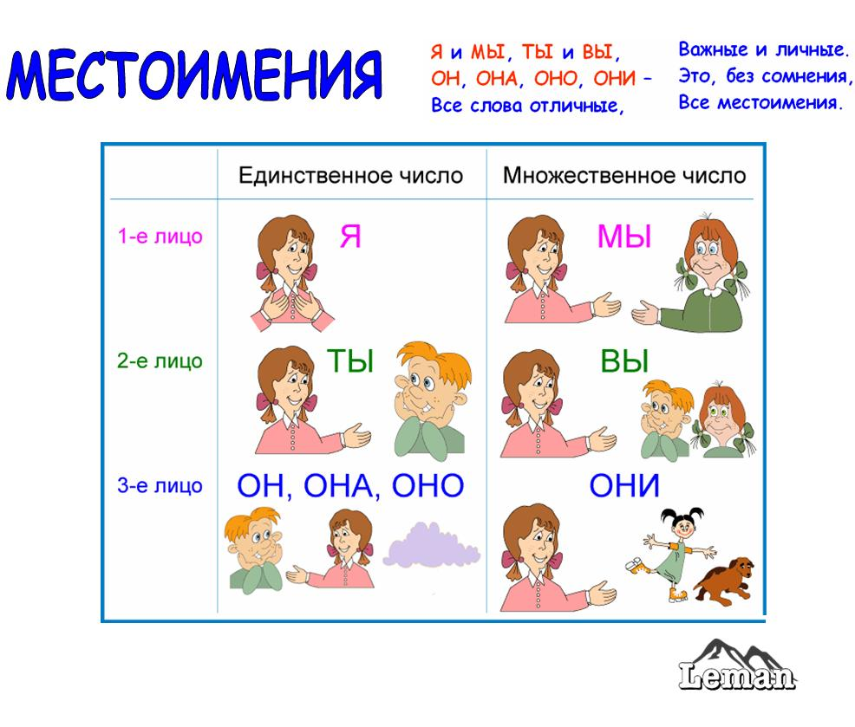
1 лицо
we

Slide 11
2 лицо
you

Slide 12
3 лицо
they

Slide 13
Тренировка грамматического материала
He is Jim. She is Jill. Jim has got a dog. The dog is black. Jill has got a cat. The cat is grey. The dog and the cat can jump

Slide 14
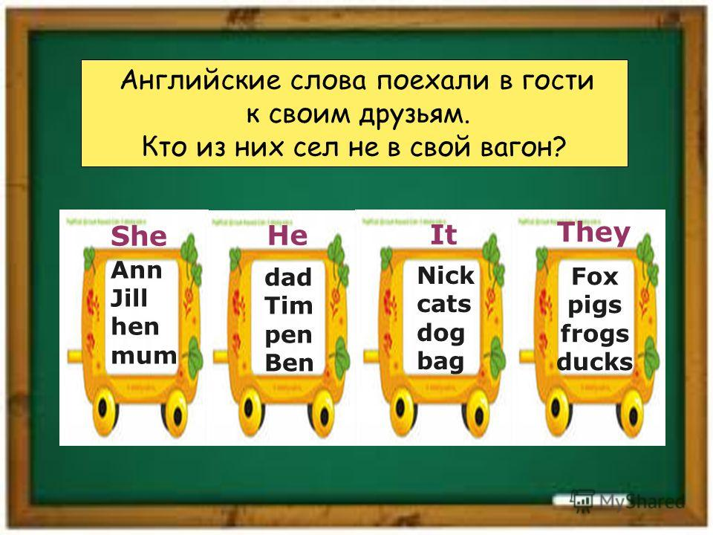

Slide 15
Физминутка
Hands up! Clap! Clap! Clap!
Hands down! Shake! Shake! Shake!
Hands on hips! Jump! Jump! Jump!
Stop! Stand still! Sit down!

Slide 16
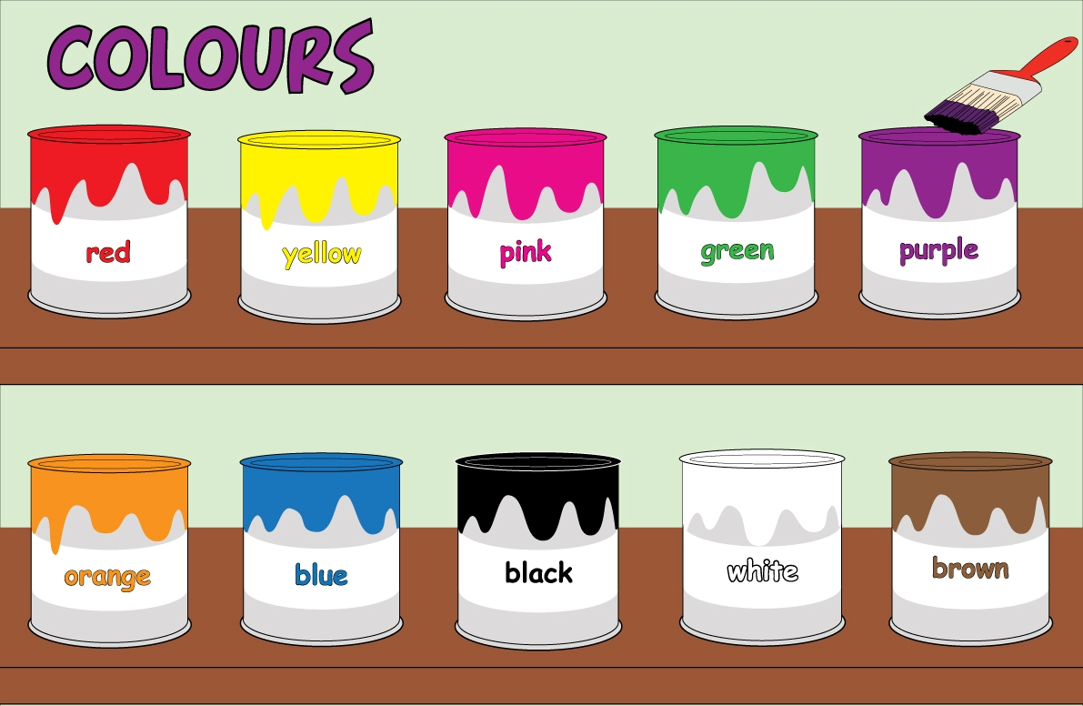
Let’s remember

Slide 17
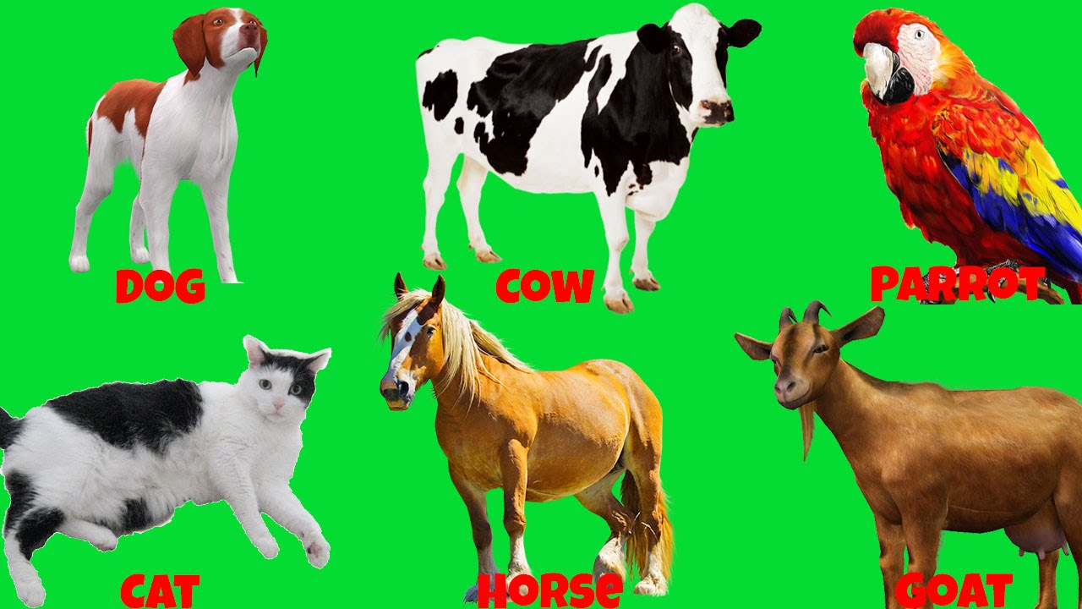
Let’s play. Listen to me

Slide 18
What is missing?

Slide 20

Read the sentences and say the number the suitable pictures
Ex.5 p. 86

Slide 21


Slide 22

Р. Т.: Урок 47

Slide 23


Slide 24




Оценивание

Slide 25


Slide 26
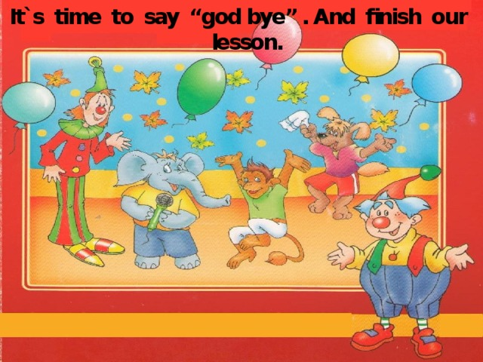

Slide 27
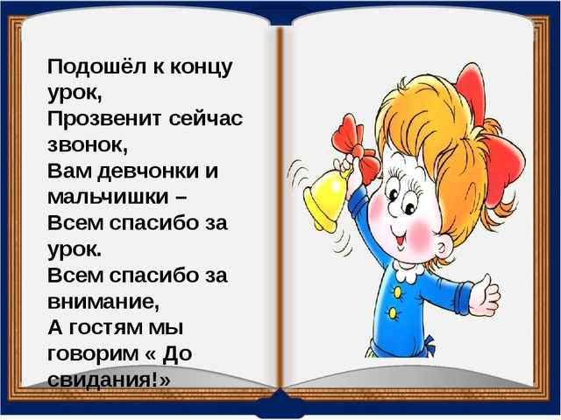
Thank you for the lesson

