Slide 1
« Impact of Social Media on Teenagers»I
Impact of Social Media On Teenagers (1).mp4

Slide 2
to train our skills like listening, reading, speaking, grammar, vocabulary, writing throughout the film “Impact of Social Media on Teenagers”.
The aim of the lesson

Slide 3
LISTENING
READING
KING
WRITING
SPEAKING
VOCABULARY
GRAMMAR
Notes:
Это другой параметр для обзорных слайдов, использующих переходы.

Slide 4
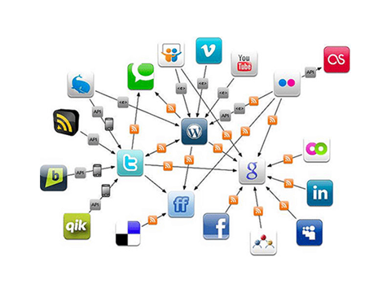
LISTENING
Impact of Social Media On Teenagers (1).mp4

Slide 5
1-FILL THE GAPS Impact of Social Media On Teenagers (1).mp4
IMPACT OF SOCIAL MEDIA ON TEENAGERS
What is the impact of social media on teenagers? Social media refers to the means of interaction among 1 ________ in which they create sheer in comment contents among themselves in virtual communities and networks. 2___________ helps to contact long – distance family and friends. It can make someone feel less shy, more outgoing and confident. He chose awareness others needs and wants. Social media is also pizza 3________ picture of life and beauty. This can lead teens changing physically and emotionally. People' s comments can affect this more than they know. Social media also leads to bulling. A simple joke could ruin someone’s 4_______. You truly never know who is behind the computer 5_______. Everyday teens are trying to leave the real world and come into the cyber world with their 6_______ picture of perfection. So ask 7________what social media is. The emm…..
PEOPLE
SOCIAL MEDIA
PERFECT
REPUTATION
SCREEN
OWN
YOURSELF

Slide 6
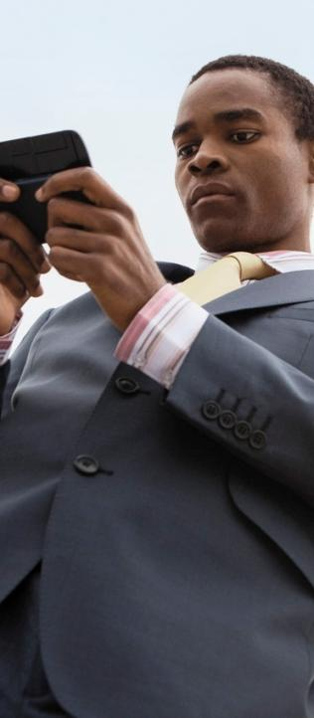
2-SAY TRUE OR FALSE ACCORDING TO THE TEXT
1- Social media refers to the means a interaction among stars of sky.
2- Social media helps contact long – distance family and friends.
3- Social media is pizza perfect picture of strawberry.
4- A simple joke couldn’t' ruin someone’s reputation.
5- You truly know who is behind the computer screen.
6- Social Media can lead teens to change physically and emotionally.
FALSE
TRUE
FALSE
FALSE
FALSE
TRUE
Notes:
Добавьте слайды в раздел по каждой теме, включая слайды с таблицами, диаграммами и изображениями.
Образцы макетов таблицы, диаграммы, изображения и видео см. в следующем разделе.

Slide 7
READING

Slide 8
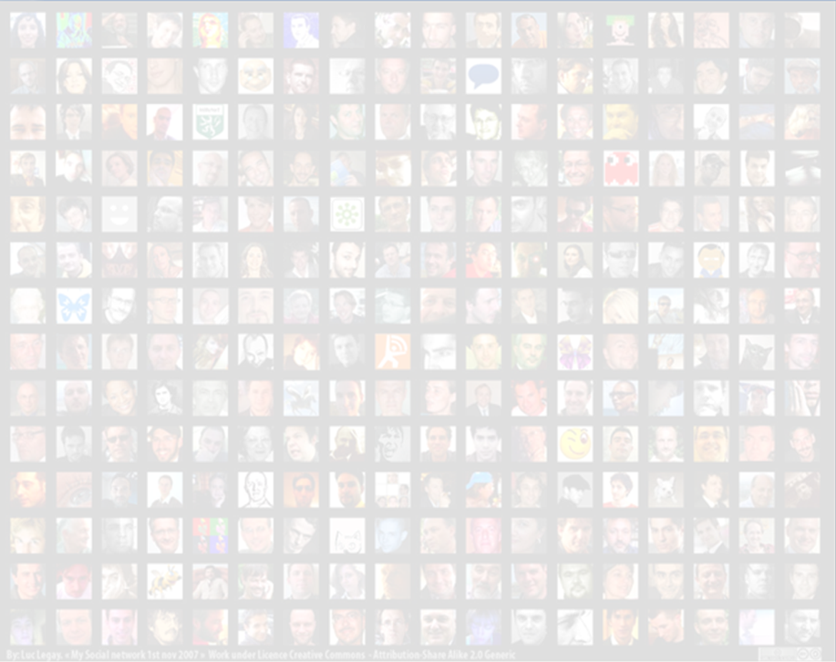
Answer the questions
2-What is for social net?
1-What is the film about?
3-What is against social net?
Notes:
Это другой параметр для обзорного слайда.

Slide 9
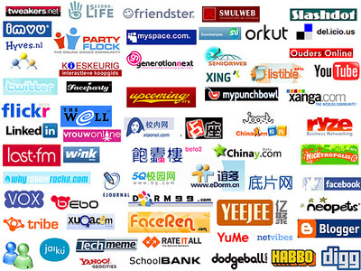
SPEAKING

Slide 10
You should study the pictures. In 1-2 minutes be ready to compare and contrast them:
give a brief description (action, location)
say what the picture have in common
say in which way the pictures are different
say which kind of picture you would prefer
explain why
You have to talk continuously.
Notes:
Добавьте слайды в раздел по каждой теме, включая слайды с таблицами, диаграммами и изображениями.
Образцы макетов таблицы, диаграммы, изображения и видео см. в следующем разделе.

Slide 11
relax
Finger Family - Caveman Family - Daddy Finger Nursery Rhyme.mp4

Slide 12
GRAMMAR

Slide 13
1-Match the grammar tenses with the verb forms
The first team
1-Past Simple | a- Social media will be referred
2-Future Simple Passive | b- Social media has referred
3-Past Continuous | c- Social media had referred
4-Present Perfect | d- Social media referred
5-Past Perfect | e- Social media was referring
The second team
1-D
2-A
3-E
4-B
5-C
1-Present Simple Passive | a- Social media was affecting
2-Past Continuous | b- Social media has affected
3-Future simple | c- Social media had affected
4-Present Perfect | d- Social media will affect
5-Past Perfect | e- Social media is affected
1-E
2-A
3-D
4-B
5-C
Notes:
Какие способности приобретут слушатели по завершении обучения? Коротко опишите каждую цель и полезность данной презентации для слушателей.

Slide 14
2- Fill in the gaps. Put the adjectives into the correct forms.
The first team
What is the (1)__________impact of social media on teenagers? And why do people prefer to chat in (2)________ community? We try to answer on this (3) the_____ ___ question. The answer will be (4)______ then we expect. | 1-strong 2-unreal 3-difficult 4-easy
STRONGEST
UNREAL
EASIER
MOST DIFFICULT
The second team
We can find (1) ________pictures in Social Media. The (2)________ faces and the (3)________figures have effects on teens. Their (4)______ psychological condition can be changed by pictures. | 1- perfect 2-beautiful 3-shapely 4-unstable
PERFECT
MOST BEAUTIFUL
MOST
SHAPELY
UNSTABLE
Notes:
Какие способности приобретут слушатели по завершении обучения? Коротко опишите каждую цель и полезность данной презентации для слушателей.

Slide 15
VOCABULARY

Slide 16
1-Put the words according to their part of speech
Interaction, people, virtual, community, outgoing, life, beauty, confident, physically, social, everyday, shy, leave, ask, emotionally, affect, media, refer, teenager.
Nouns | Verbs | Adjectives | Adverbs
Interaction, people, community, life, beauty, media, teenager.
Leave, ask, affect, refer.
Shy, outgoing, confident, social, virtual.
Physically, emotionally, everyday.
Notes:
Будьте кратки. Сделайте текст как можно более кратким для использования крупного шрифта.

Slide 17
WRITING

Slide 18
1-Read and translate the words in the box. Fill in the blanks with the corresponding words. There is one extra word in the box: 2-Find out six mistakes in the structure of the letter.
questions listen to back hobby better Moreover
Russia
Irkutsk
11/11/15
Dear Sam
Thank you for your interesting letter. I was glad to hear from you again!
Anyway, write(1)_______ and tell me about your holiday. Did you enjoy it? What unusual places did you visit? Did you make a lot of photos?
Well, I will try to answer your (2)________. No doubt social net have made our life more interesting and exciting. Sometimes, we needn’t meet with our friends as we can chat on the social net. (3)_________, social net helps us to relax although some teens feel they are rather addictive. As for me, I am happy that I am consisted on the net. It help me with my (4)________ – photos and I also look through different photos, (5)________ music, chat with my friends, read interesting articles in the groups and play computer games.
I'd (6)__________ go now as I have to feed my puppy.
All the best with love
Artem Sokolov.
IRKUTSK
RUSSIA
,
BACK
QUESTIONS
MOREOVER
LISTEN TO
HOBBY
BETTER
,

Slide 19
HOME WORK:
You have received a letter from your English pen friend who writes:
…….We are doing a project at school on how social net are changing teens' lives. Please could you tell me how social net are changing things and what teens think of them? Are you consisted in social net? What do you use it for?
As for me, I went for a holiday with my parents last weekend…..
Write back to Sam.
In your letter
-answer his questions;
-ask 3 questions about his holiday.
Write 100-140 words.
Notes:
Добавьте пример или смоделированную ситуацию для обсуждения и применения полученных знаний.

Slide 20
GOOD BYE!

