Slide 1
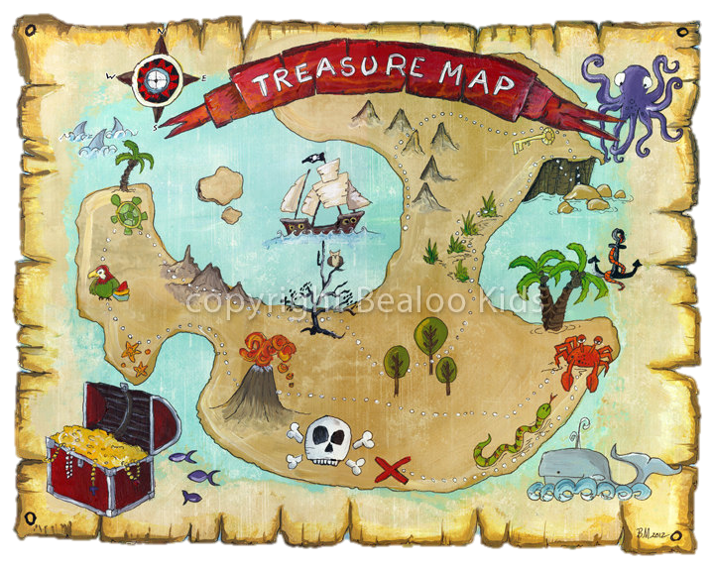
«In search of treasure»
(В поисках сокровищ)
Внеклассное мероприятие
по английскому языку
для 6-7 классов
Подготовила: учительница
английского языка
ГУО «Средняя школа №33 г. Могилева»
Дорошенко Елена Николаевна

Slide 2
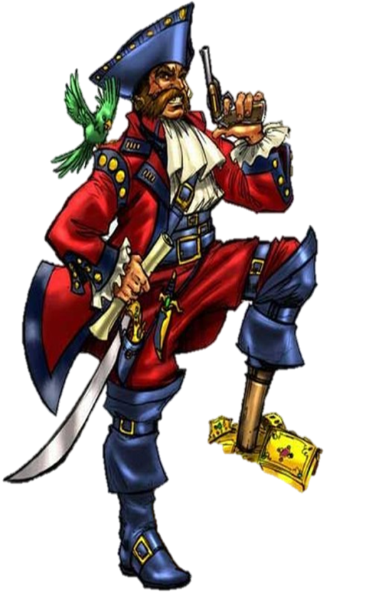
«Who wants to be a millionaire?»
1. The capital of Great Britain is:
Moscow
B:
London
A:
C:
Paris
D:
New-York

Slide 3
2. When does the UK celebrate
Halloween?
A:
31 of October
B:
27 of November
C:
31 of November
D:
27 of October

Slide 4
3. Where do men wear skirts (kilts)?
America
Scotland
A:
B:
Italy
Russia
C:
D:

Slide 5
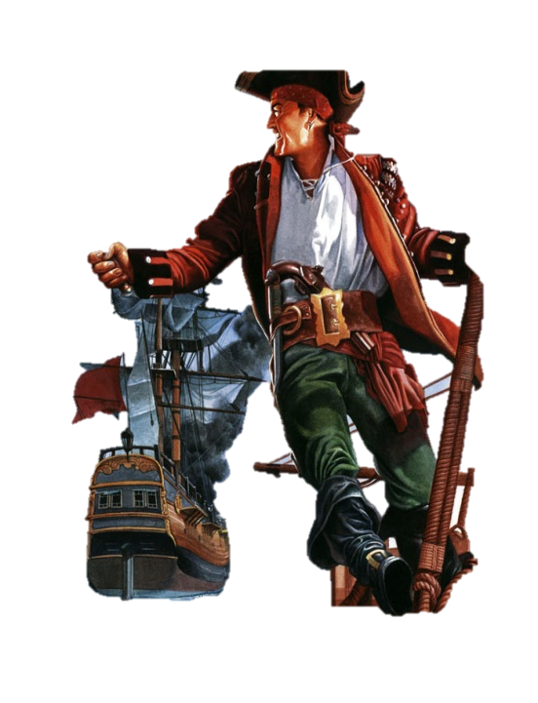
4. Ничего уютней нет,
Чем моя квартира …
Всё уютно и привычно,
На стене картина …
Чтобы время знать я мог,
Есть часы большие…
haus, cartina, klock
flat, picture, clok
A:
B:
flat, picture, clock
flet, pictur, klok
C:
D:

Slide 6
5. Where can you see a kangaroo?
India
Australia
A:
B:
C:
Ukraine
Canada
D:

Slide 7
6. Bunny is a symbol of:
Halloween
Birthday
A:
B:
C:
Christmas
Easter
D:

Slide 8
7. Fill in the missing word.
There are a lot of … in Saint-Petersburg.
yesterday
museums
A:
B:
C:
week
computer
D:

Slide 9
8. Traditional English houses
usually have…
1 floor
B:
2 floors
A:
C:
3 floors
D.
4 floors

Slide 10
9. The Wimbledon Championship is the oldest ... tournament in the world.
football
baseball
A:
B:
C:
tennis
hockey
D:

Slide 11
10. At what age do children in the UK usually go to school?
5 years
6 years
A:
B:
C:
7 years
8 years
D:

Slide 12
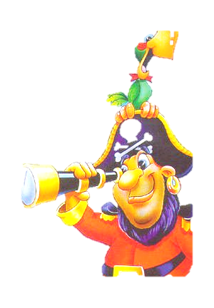
Are you a pirate or a captain?
I’m strong and brave;
I’m a bit lazy;
I’m afraid of sharks;
I’m a bit bossy;
I’m good at languages;
I’m good at geography;
I can swim 200 metres;
I can make a model ship;
I can read a map;
I prefer the beach to
mountains.
I can climb a rope;
I like studying stars;
I like fish;
I like watching pirate films;
I like adventure stories;
I’ve got a pet parrot;
I’ve got a compass;
I’ve got a map of the world;
I’ve got a pirate’s sword;
I prefer boats to buses or planes;

Slide 13
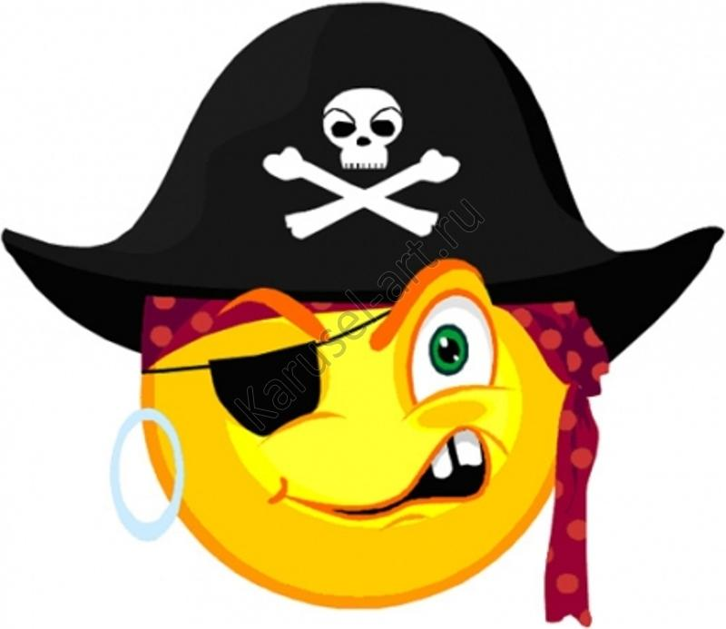
Thank you for your
attention!!!

