Slide 1
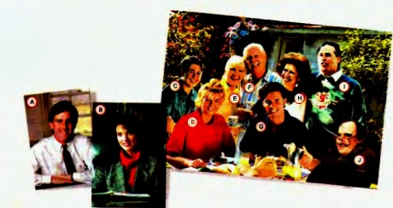
What makes a family?

Slide 2
Family values
Caring | Забота, внимательность
Sharing | Разделение, рапределение
Mutual respect | Взаимоуважение
Security | Безопасность, благополучие
Comfort | Поддержка, успокоение
Privacy [‘privəsi], [praivəsi] | Частная сфера
Trust | доверие

Slide 3
What family value is this?
feeling that someone is important, so that you are interested in them, worried about them, etc.
caring
2. having the same opinion, experience, feeling etc. as someone else
sharing

Slide 4
What family value is this?
3. an attitude of regarding someone as important so that you are careful not to harm them, treat them rudely, etc.
Respect
4. state of being protected from the bad things that could happen to you
security

Slide 5
What family value is this?
5. feeling of being more calm, cheerful, or hopeful after you have been worried or unhappy
comfort
6. the state of being free from public attention
privacy
7. a strong belief in the honesty, goodness etc. of someone or something
trust

Slide 6
Read the statements below. What family values or the" absence (see ex, 4A) do they describe? More than one choice is possible.
a) A family has things together... like dreams and hopes and possessions and memories and smiles...
b) It is a shelter from the storm... a friendly port when the waves of life become too wild. c) With so many people in one house you don't have a chance to be alone, unseen, or unheard.
d) Whatever I say my family will take my word against anybody else's... e) A family is a place where love and faith dwell ... I a place where all members can enjoy the dignity (достоинство) of their own personalities. f) We talk about what's happening, who's doing what, it's lovely to have the family round you and to know they are Interested in you.

Slide 7
Continue the sentences in pairs
Continue the sentences with your own idea
Discuss the ideas with your partner
Choose the best idea from the two and read it aloud.
Example: When it’s tough I find comfort in my family because there’s always someone who … will listen to me and give some advice.

Slide 8
Sentences
In an extended family one can always find comfort because there’s always someone who …
I share my worries and problems with my family because there’s always someone who …
We are so lucky to have a caring family because there’s always someone who …
In our family we always try to show each other our respect because we …
I trust my family because I …
I’m sure that I can find security in my family because there’s always someone who …
In an extended family it’s difficult to find privacy because …

Slide 9
Statements:
1 We only need a family for comfort and protection. 2 Sharing feelings comes after sharing a meal. 3 Privacy is impossible in an extended family. 4 Too much caring is annoying. 5 Mutual respect can substitute for love in a family. 6 Trust IS more important for a happy family than any other feature.

Slide 10
№5 p.74 Try to reach an agreement on the statements below.
In pairs decide which of the following statements you agree or disagree with,
Negotiate in pairs and come to an agreement
Explain your point
Be ready to report the results of your discussion to the class

Slide 11
Tips for reporting results
We’ve chosen a statement number … ….
We agree/disagree with it because, in our opinion, …
Also, …
Besides, …

Slide 12
Self evaluation card
1 | I can name the family values
2 | I can find the synonyms to the words expressing family values
3 | I can describe (описать) the family values
4 | I can express my opinion about the statements
5 | I can discuss and come to an agreement with my partner
Mark

Slide 13
Tips for evaluation:
Read all the points
Put plus (+) if you are able to do them easily
Put minus (-) if you think it’s still difficult for you to do it
Say your opinion in reflection:
It was easy to …
It was difficult to …
Now I know …
Now I can …

