Slide 1
April, 9

Slide 2
Listen and repeat
run – бегать
fly – летать
jump – прыгать
swim - плавать

Slide 3
      I can Я могу
      You can Ты можешь
      He can Он может
      She can Она может
      It can

Slide 4
  Can I
  Can you
  Can he run?
  Can she
  Can it

Slide 5
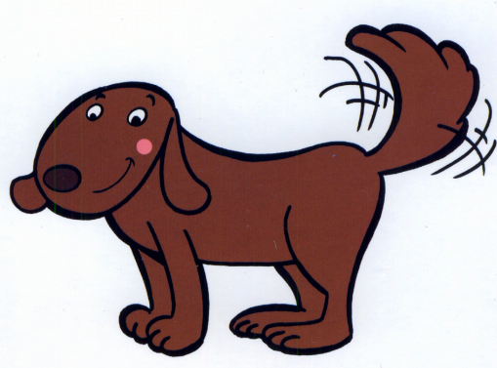
I have a dog.
It can run.

Slide 6
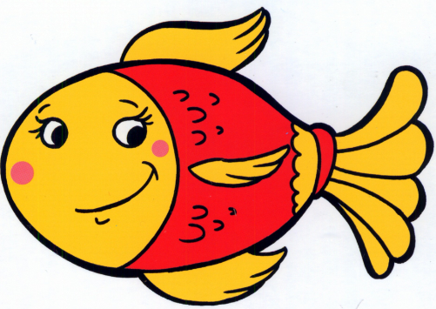
I have a fish.
It can swim.

Slide 7
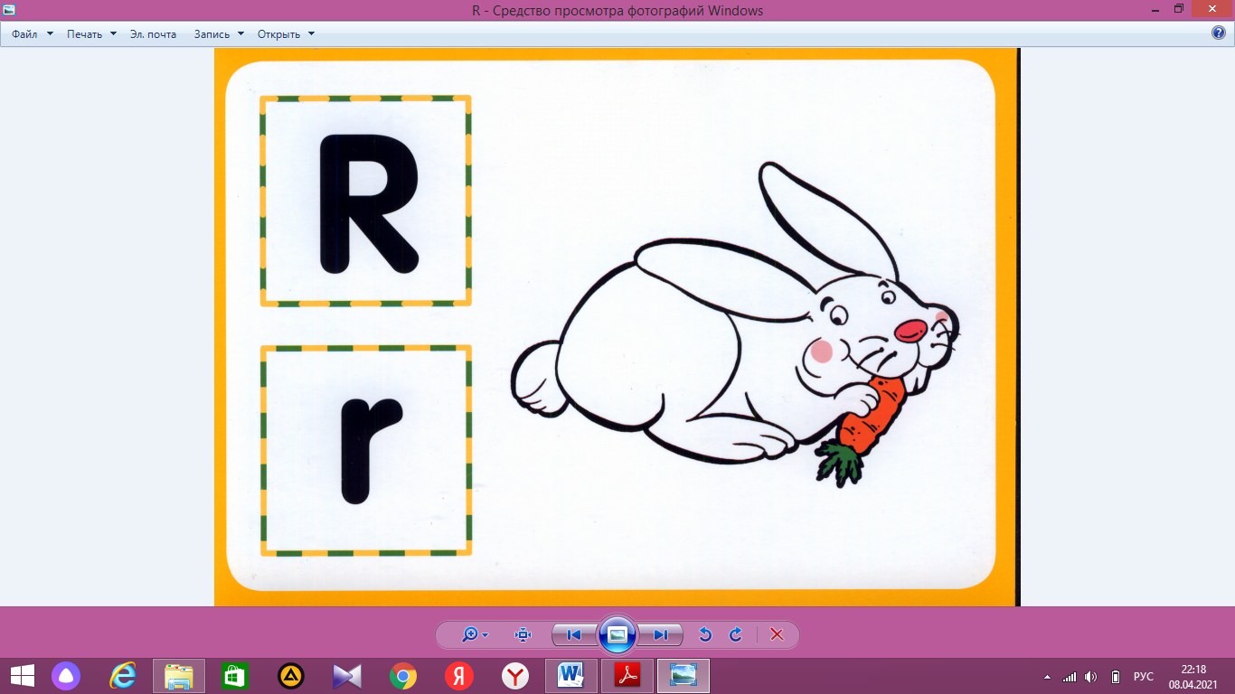
I have a rabbit.
It can run.

Slide 8
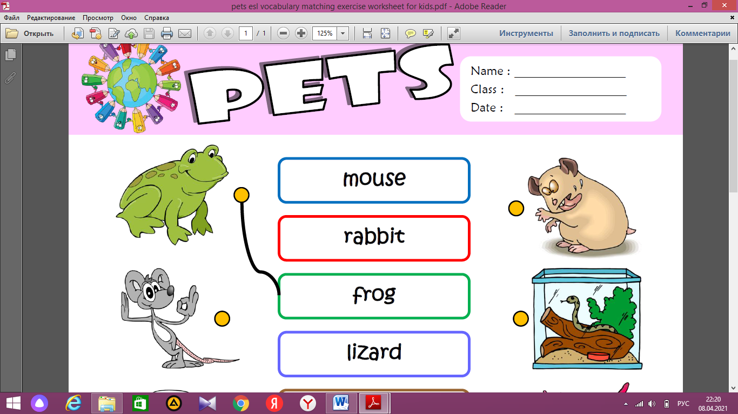
I have a frog.
It can jump.

Slide 9
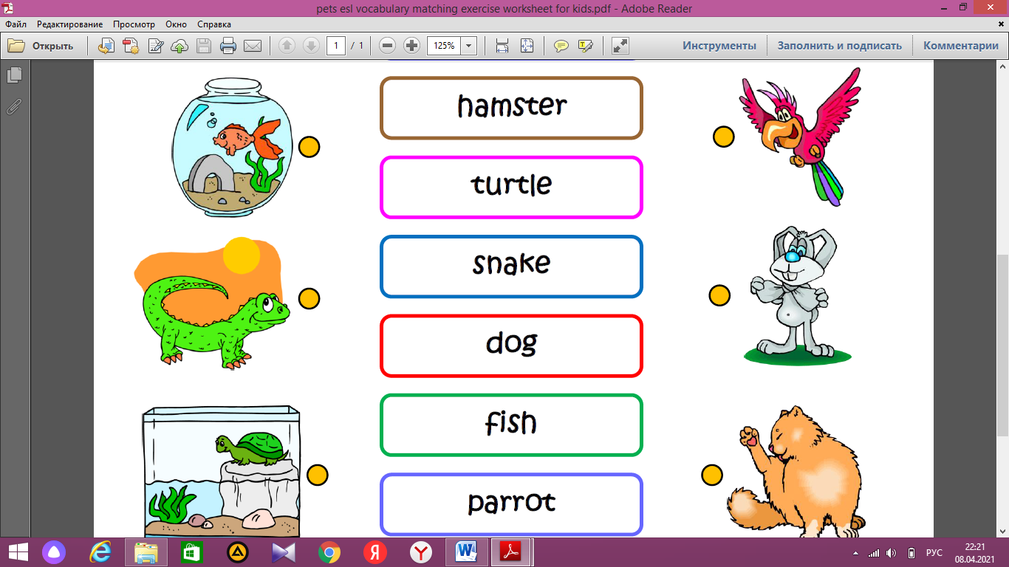
I have a parrot.
It can fly.

Slide 10
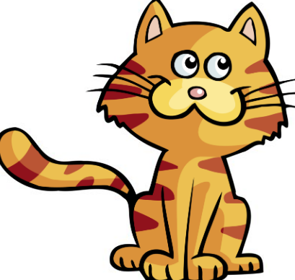
I have a cat.
It can run and jump.

Slide 11
It can run.
Can it run?
Yes, it can.

Slide 12
It can fly.
Can it fly?
No, it can’t.

